Slide 1
RISE Advocacy Chapter December Webinar
December 12, 2023
Notes:
Ken

Slide 2
Welcome
Please let us know in the chat where you are joining us from!
Notes:
Ken

Slide 3
Mission & Vision
Together Women Rise’s Mission
Together Women Rise cultivates the collective power of community to achieve global gender equality.
OUR VISION
Together Women Rise envisions a world where every person has the same opportunities to thrive regardless of their gender or where they live.
Notes:
Ken

Slide 4
Our Values & Resources
​At RESULTS we pledge to create space for all voices, including those of us who are currently experiencing poverty. We will address oppressive behavior in our interactions, families, communities, work, and world. Our strength is rooted in our diversity of experiences, not in our assumptions.
With unearned privilege comes the responsibility to act so the burden to educate and change doesn’t fall solely on those experiencing oppression. When we miss the mark on our values, we will acknowledge our mistake, seek forgiveness, learn, and work together as a community to pursue equity.
Read our full anti-oppression values statement here at results.org/values.
Find these resources and more at results.org/volunteers/anti-oppression:
Resource Guides from our Diversity & Inclusion trainings, including:
Interrupting Microaggressions
Creating Space for Critical Conversations
Information on how RESULTS responds to oppressive incidents
Stay tuned for 2024 workshop schedule!
Notes:
Ken

Slide 5
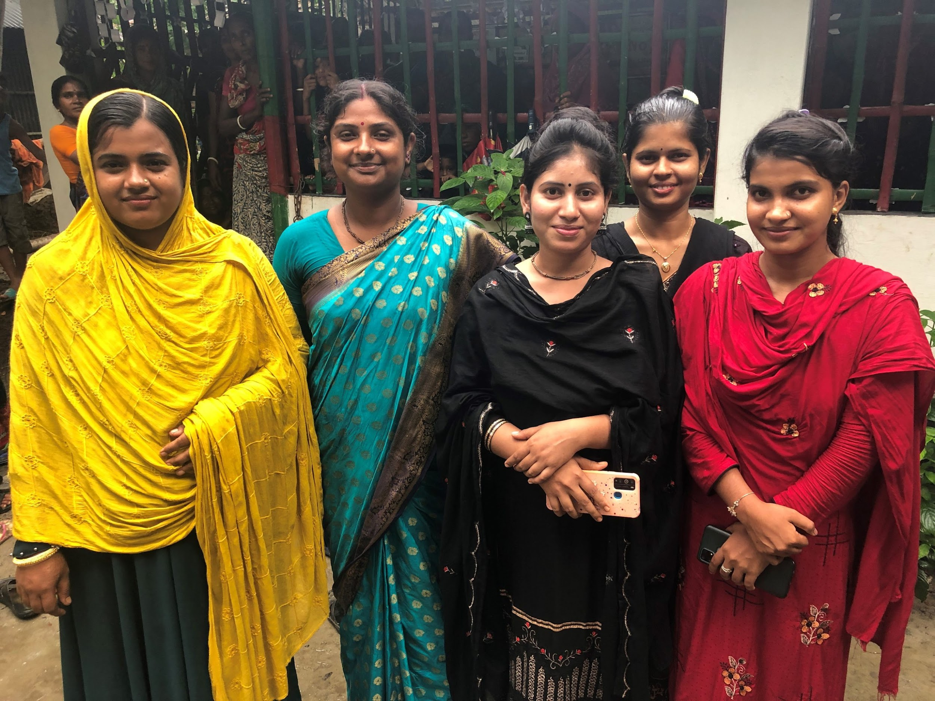
Grantee Spotlight
Girls Education Program (GEP)
Notes:
Margaret

Slide 6
Grantee Spotlight34 e
Speak Up For The Poor
Grant Amount: $50,000 Mission of Children of Vietnam Speak Up for the Poor’s mission is to create a new reality for girls in poverty.
Project Summary
The Girls Education Program helps girls from impoverished families who are vulnerable to child marriage and child trafficking to stay in school all the way through college graduation. This both changes the trajectory of those girls’ and young women’s lives, and also elevates the status of girls and women in the culture, as for the first time people see examples of girls and women who are staying in school through higher education, and becoming educated professionals. Grant funding from Together Women Rise will fund health and safety trainings and resources throughout 2024, for girls and young women in Speak Up's GEP.
Notes:
Margaret

Slide 7
Grantee Spotlight
Speak Up For The Poor
Why We Love This Project
Speak Up For the Poor was the February 2021 featured grantee; had a total of 121 young women in college, nursing school, or other higher education through the Girls Education Program.
Today, they have 41 college and nursing school graduates, and 235 other young women currently studying in college, nursing school, and other higher education.
All in communities with very high rates of child marriage for girls. (Bangladesh has one of the highest rates of child marriage in the world for girls under age 15.)
GEP has been very successful the past few years, and is making a tremendous difference for these girls and young women.

Slide 8
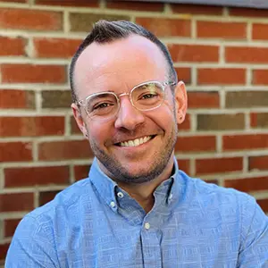
Tonight’s Speaker
Colin Puzo Smith Director
RESULTS, Global Policy

Slide 9
Global policy
Our Fall Goal
Congress prioritizes equity and impact in the fight against global poverty
Notes:
Ken

Slide 10
Equity & Impact
Who does it reach? Who gets left out?
Are we working in partnership?
How is funding delivered?
Are interventions based on evidence?
Notes:
Ken

Slide 11
Part 1
How the U.S. government spends money and designs programs
Part 2
How the World Bank spends money and designs programs
Notes:
Ken

Slide 12
Global Advocacy Campaigns
Malnutrition Prevention & Treatment Act
The End Tuberculosis Now Act
The READ Act
Notes:
Ken

Slide 13
What's going on in this House?!?
Congressional Updates
Notes:
Ken

Slide 14
Asks on TB Right Now
Ask Reps and Senators to cosponsor the End TB Now Act and speak to House/Senate leadership about passing it ASAP.
Tip: Leverage your work on the House and Senate TB sign-on letters:
Share final letter and thank those who signed. Ask them to cosponsor End TB Now Act and speak to leadership.
Share final letter with those who didn't sign as well and let them know they can still make a difference on TB by cosponsoring the End TB Now Act.
Notes:
Ken

Slide 15
Asks on READ Act Now
READ in the House: Ask Reps. to cosponsor the READ Act and speak to Foreign Affairs leadership (McCaul, Meeks) about moving the bill out of committee ASAP.
READ in the Senate: Ask Senators to cosponsor READ Act and speak to Senate leadership about passing it ASAP.
Notes:
Ken

Slide 16
Advocacy Action: Moving READ Across the Finish Line!
Notes:
Karyne

Slide 17
Advocacy Action
the Senate passed the READ Act Reauthorization Act (S. 41) the bill passed by voice vote, with no opposition. This bipartisan support is a result of your persistent advocacy throughout this year.
We still need the House to step up. You can take this online action to ask your Representative to push the House Foreign Affairs Committee (HFAC) leadership and House leadership to prioritize moving the READ Act Reauthorization Act (H.R.681) before the end of the year.
In pushing for co-sponsors and asking for the bill to be prioritized, you proved to Senate leadership that global education is a critical issue.
The READ Act Reauthorization Act would extend the 2017 READ Act for five years. It would make their programs more effective, affirming the U.S.’s stance that every child has the right to a quality education. Read more on our blog post – “The Senate passes the READ Act Reauthorization: here are some steps to ensure it becomes law!”
Notes:
Karyne

Slide 18
Advocacy Action: Media Push for Global Education
Notes:
Karyne

Slide 19
Why we use media?
Making connections between the issues we advocate on and current events
Bringing awareness of these issues to our community (more constituents)
Puts pressure on MOCs to act (they monitor what is being said about them in the media)
Notes:
Karyne

Slide 20
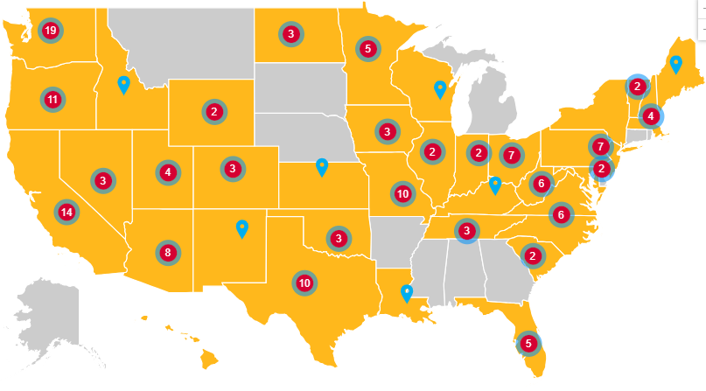

Slide 21
Recently Published LTEs
Notes:
Karyne
Recently Published Media – Link to all media: https://results.org/wp-content/uploads/RESULTS-Global-Poverty-Media-Packet-current-2023.pdf
Letter: Millions missing out on education - https://www.havasunews.com/opinion/letter-millions-missing-out-on-education/article_06cbad1e-58ce-11ee-b5d4-9b1beaaccde2.html
Global education crisis is a problem America can help fix - https://chicago.suntimes.com/2023/9/20/23880500/global-education-unesco-children-no-cash-bail-joe-biden-donald-trump-age-letters
Letter: US must continue to support global education - https://www.berkshireeagle.com/opinion/letters_to_editor/letter-us-must-continue-to-support-global-education/article_8a7b0bb8-272e-11ee-9171-0ba765f82ca8.html
US must lead on global ed - https://www.masslive.com/opinion/2023/09/springfield-renters-deserve-say-on-housing-problems-letters-to-the-republican.html
times west virginian - https://www.timeswv.com/opinion/readers_write/children-need-congress-to-pass-the-read-reauthorization-act/article_8d198400-5ca6-11ee-a8ba-974b805319e1.html

Slide 22
Your letters are still critical as we approach the end of the year!

Slide 23
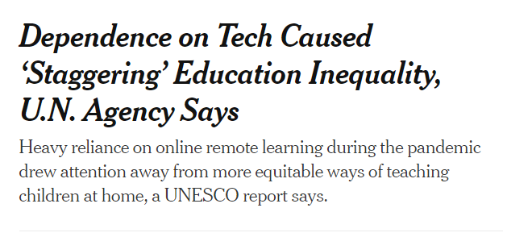
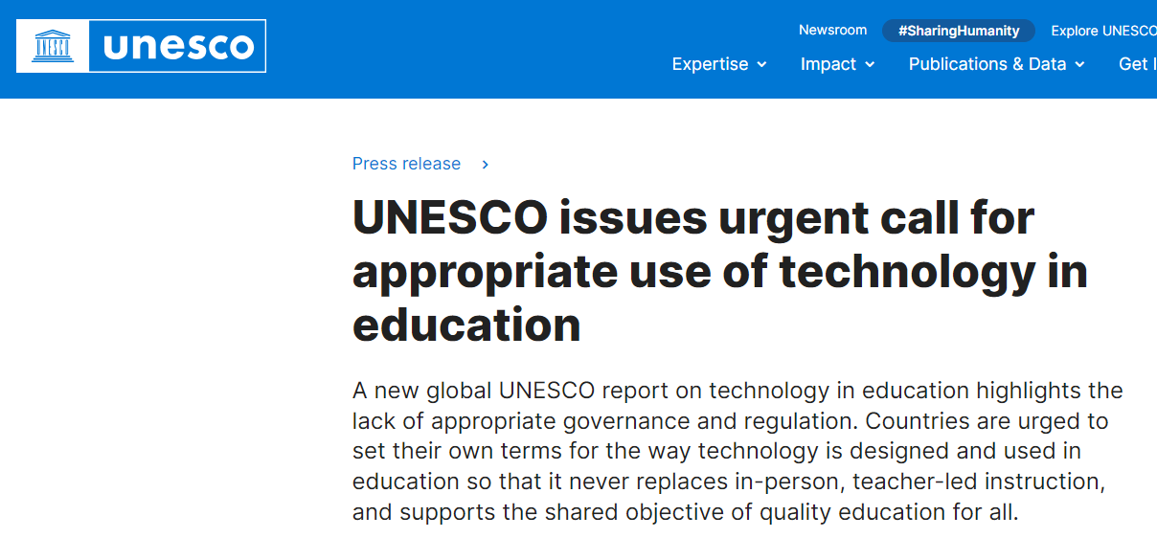
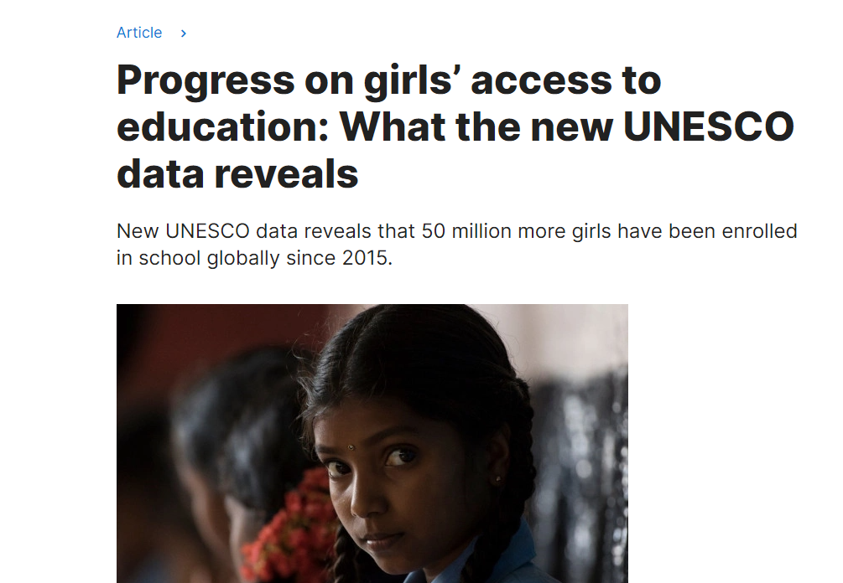
Follow the media
Notes:
Karyne
UNESCO - Progress on girls’ access to education - https://www.unesco.org/en/articles/progress-girls-access-education-what-new-unesco-data-reveals
Dependence on Tech Caused ‘Staggering’ Education Inequality, U.N. Agency Says - https://www.nytimes.com/2023/09/06/technology/unesco-report-remote-learning-inequity.html
WVO Abandons Award-winning Global Edu Program - https://www.insidehighered.com/opinion/views/2023/09/21/wvu-abandons-award-winning-global-education-opinion
UNESCO Appropriate use of technology - https://www.unesco.org/en/articles/unesco-issues-urgent-call-appropriate-use-technology-education
Lost in a world of words, Boston Globe article - https://apps.bostonglobe.com/metro/2023/10/literacy-education-strategies/

Slide 24
How do you get started?
Find a local hook
Articles in the paper?
Respond to other published media (making connection to other health issues)
Thank you to your Senator, call to action to your Rep!

Slide 25
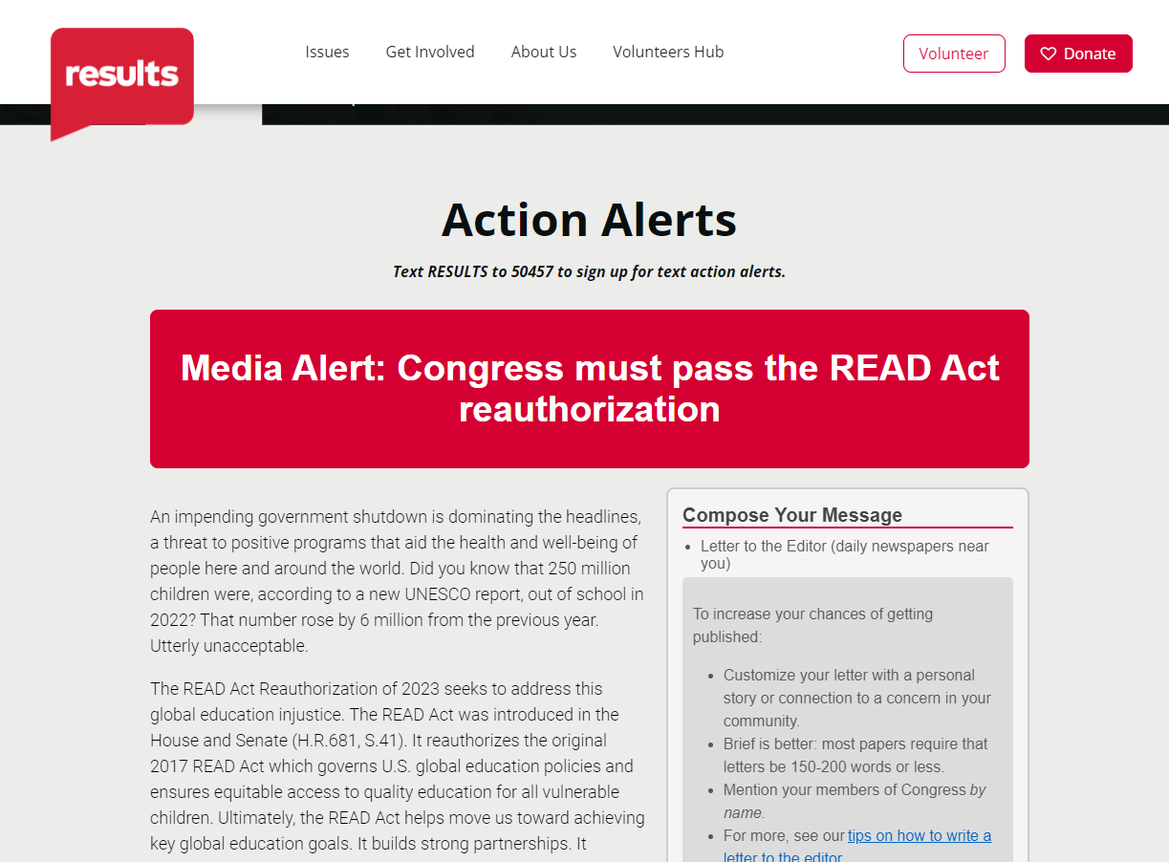
Submitting an LTE
Use sample LTE template to get you started, make it personal
https://results.org/volunteers/action-center/action-alerts?vvsrc=%2fcampaigns%2f87023%2frespond

Slide 26
Together Women Rise Orientation Webinar Tuesday, January 17 at 8:30 PM ET
Together Women Rise Grantees
If you would like to learn more about RISE grantees, there are chapters across the US, as well as a virtual national chapter meeting with a speaker from the grantee each month on the first Thursday of the month at 8 PM ET: https://togetherwomenrise.org/upcoming-events/
Closing
Notes:
Ken
Join us for the upcoming Together Women Rise Advocacy Chapter Orientation on Wednesday, January 17 at 8:30 PM ET to learn more: https://tinyurl.com/2024RiseAdvocacyOrientation
Sign up for the Advocacy Chapter

Slide 27
Happy Holidays and
thank you for your advocacy
this year!

