Slide 1
DFW Advocacy Chapter with RESULTS
November Webinar: COVID & Beyond
November 17 & 18, 2020
Notes:
Leslye

Slide 2
Welcome New Advocates
Partnership between DFW and RESULTS
Welcome those who are new to the chapter
No advocacy experience required, but it does require us venturing outside our comfort zone to make a difference.
Let’s do this together!
Notes:
Leslye
Welcome newcomers and those who got started last month

Slide 3
Zoom Instructions
We want to hear from you, but please stay muted unless speaking. To unmute, click the microphone icon, dial *6 on the phone, or raise your hand so we can unmute you.
Also share comments and/or questions using the “Chat” icon
Notes:
Leslye

Slide 4
New Mission & Vision
DFW’s NEW MISSION
Dining for Women cultivates the collective power of community
to achieve global gender equality.
DFW’s OUR NEW VISION
Dining for Women envisions a world where every person
has the same opportunities to thrive
regardless of their gender or where they live.
Notes:
Leslye

Slide 5
Getting Connected
Ice Breaker
Share one or two sentences: How do you feel about what you and DFW have done through advocacy in 2020?
Share one or two sentences: What should this group strive for in 2021?
Notes:
Leslye

Slide 6
Goals for Today
Review some of DFW outputs for 2020 and possibilities for 2021
Prepare to take top action. We have lost time on poverty due to government. We must continue to insist on action.
Review First 100 Days opportunity. Time for DFW to shine brightly.
Notes:
Leslye

Slide 7
What are We Trying to Do
as Advocates?
We work in a non-partisan way to influence our decision makers in Congress, guiding them toward solutions that will positively impact the lives of women, girls, and children living in poverty.
Notes:
Leslye
Even members of Congress who seem to support these issues need to be contacted—they often don’t know about opportunities for action, or won’t take them unless they hear from constituents.

Slide 8
Assess where our members of Congress are on the Champion Scale, then move them up
What are We Trying to Do
as Advocates?
4 Champion
3 Leader
2 Advocate
1 Supporter
0 Uninformed or Neutral
-1 Opponent
Notes:
Leslye
Any move we make on the Champion Scale is a win. If they move from Opponent to silence, there is less opposition. If we move them from a supporter to advocating with another member of Congress, it is a win. We do this through relationship building.

Slide 9
Original 2020 Campaigns
Improve maternal health and child survival:
Ensure the US is funding maternal & child health, child vaccinations, and child nutrition at robust levels for FY21 (In progress—looking positive with recent Senate bill)
Ensure the US pledges to fund Gavi, the Vaccine Alliance’s 5-year work plan (Complete—successful!!)
Global COVID-19 response: ADDED & in progress
Ensure that US and world leaders make serious commitments to end child malnutrition (pushed to 2021)
Notes:
Leslye

Slide 10
 | FY18 | FY19 | FY20 | President’s FY21 Request | RESULTS FY21 Request | House FY21 | Senate FY21
Global Fund to Fight AIDS, TB, and Malaria | $1.35 billion | $1.35 billion | $1.56 billion | $658 million | $1.56 billion | $1.56 billion | $1.56 billion
Maternal and Child Health | $814.5 million | $835 million | $851 million | $659.6 million | $900 million | $850 million | $865 million
Of which Gavi, the Vaccine Alliance | $275 million | $290 million | $290 million | $290 million | $290 million | $290 million | $290 million
Notes:
Leslye

Slide 11
Why is DFW working on COVID?
COVID-19 is increasing the risk of child marriage as a response to school closures, growing risks of violence, adolescent pregnancy, and food and economic insecurity. Estimates suggest that for the first time in almost 30 years, girls are more, not less at risk of child marriage.
An estimated 90–117 million more children will fall into poverty in 2020.
Since programs addressing FGM are often interactive and communal, many have been disrupted by the pandemic. UNFPA estimates that this will lead to 2 million cases of FGM that would otherwise have been avoided.
Notes:
If children are falling into poverty it’s because their mothers are falling into poverty.

Slide 12
Why is DFW working on Covid?
It is estimated that if the average COVID-19 lockdown period reaches six months, 47 million women and girls will lose access to modern contraception, resulting in an additional 7 million unintended pregnancies. Many of these will be high-risk pregnancies among adolescent girls, particularly as COVID-19 lockdown measures and redirected funds reduce access to sexual and reproductive health services
Notes:
If children are falling into poverty it’s because their mothers are falling into poverty.

Slide 13
Why is DFW working on Covid?
It is estimated that hunger and malnutrition will double globally.
Malnourished girls are 15% more likely to give birth to malnourished babies than well-nourished adult mothers, and more likely to have babies born with disabilities.
Notes:
If children are falling into poverty it’s because their mothers are falling into poverty.

Slide 14
Why is DFW working on Covid?
School closures paired with disrupted access to reproductive health services, particularly in rural and low-income areas, will lead to higher rates of unplanned pregnancies.
As a result of the COVID-19 crisis, Save the Children estimates that the number of girls at risk of child marriage could increase by up to 2.5 million.
Save the Children estimates that more than 1 million girls will face risk of adolescent pregnancy as a result of the economic impacts of COVID-19 expected in 2020.
Notes:
If children are falling into poverty it’s because their mothers are falling into poverty.

Slide 15
Why is DFW working on Covid?
The situation for women, girls, children is urgent.
“Around 435 million women and girls will be living on less than $1.90 a day by 2021, including 47 million pushed into poverty as a result of COVID-19, according to the new U.N. findings…Unless Congress acts, progress could be set back 10-20 years on AIDS, TB, malaria, vaccinations, maternal and child deaths, etc.”
--Article: Pandemic is widening poverty gap between women and men, new UN findings show, 9/2/20
Notes:
Leslye

Slide 16
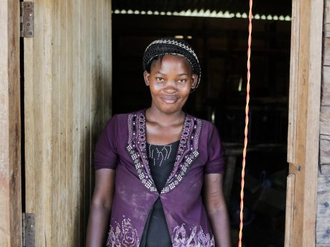
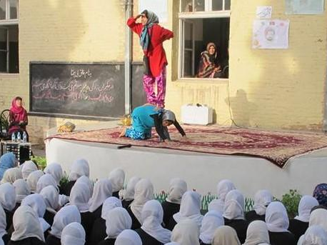
Dining For Women November Grantees
2013 remark by Defense Secretary James Mattis while commander of US Central Command: "If you don't fully fund the State Department, then I need to buy more ammunition."
In 2017, 120 retired generals and admirals signed a letter stating:
"The State Department, USAID, Millennium Challenge Corporation, Peace Corps and other development agencies are critical to preventing conflict and reducing the need to put our men and women in uniform in harm's way,"
https://www.cnn.com/2017/02/27/politics/generals-letter-state-department-budget-cuts/index.html
Featured Grantee: Resolve Network
Democratic Republic of the Congo
Sustained Grantee: Afghanistan
Bond Street Theatre
"Women are strong. I am strong. I am recovering from war. I am building my business with my own hands. I will succeed. People call me 'Mama Resolve' since I named my daughter Resolve for this change in my life.” ~Mama Resolve
If you recall from our August meeting, BST had put their project on hold, not just because of COVID, but because of renewed violence from the Taliban.

Slide 17
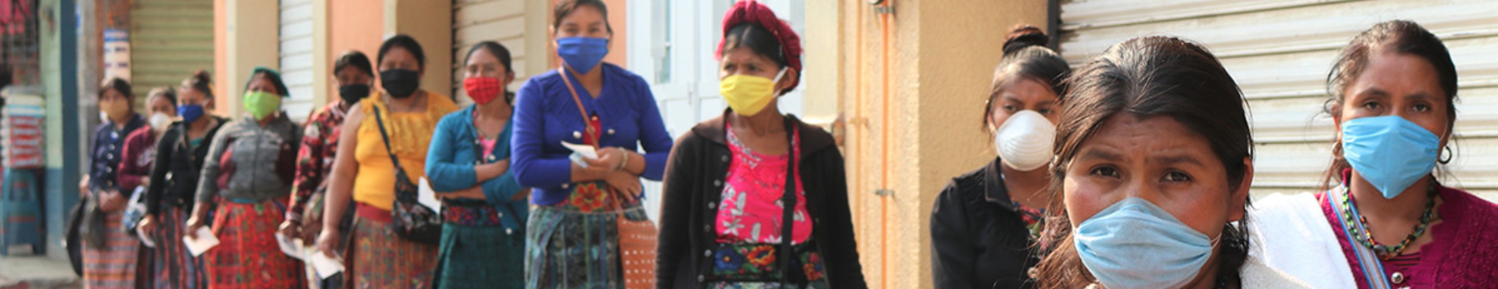
Update on USAID funding in Guatemala
Project Concern International
In July, we heard from Mabel and Salvador with PCI about the current situation in Guatemala.
Emergency Food Security Program called Animo (which means security in Spanish) has been refunded.
This is thanks to previous work pushing Congress and the Administration to fully fund foreign aid!

Slide 18
Where Are Things Now?
Government is funded through Dec. 11, so needs to pass bills to keep government funded beyond that
Little happening between House, Senate, Administration on COVID-19 supplemental bill
Senate FY21 SFOPS bill looks okay for normal year, but no supplemental funding
House HEROES Act 2.0 includes $10 billion for development assistance as does FY21 SFOPS bill
Notes:
Leslye

Slide 19
Taking Action
Leverage our media and contact your members of Congress, calling on them to speak to leadership about passing a COVID relief bill that includes a global response now.
Senators are key. If we can get 5-6 Republican senators to speak to McConnell, it could make a difference. But all senators need to hear from us.

Slide 20
Taking Action
Review how to find our members of Congress and staff names.
Review how to form email addreses:
  House: firstname.lastname@mail.house.gov
  Senate: firstname_lastname@SenatorLastName.senate.gov

Slide 21
Direct Advocacy
21
Questions?

Slide 22


Slide 23

Looking Ahead:
First 100 Days Goals
Meet with all 100 Senate offices by May 1
Meet with 3/4 of the House offices by May 1

Slide 24
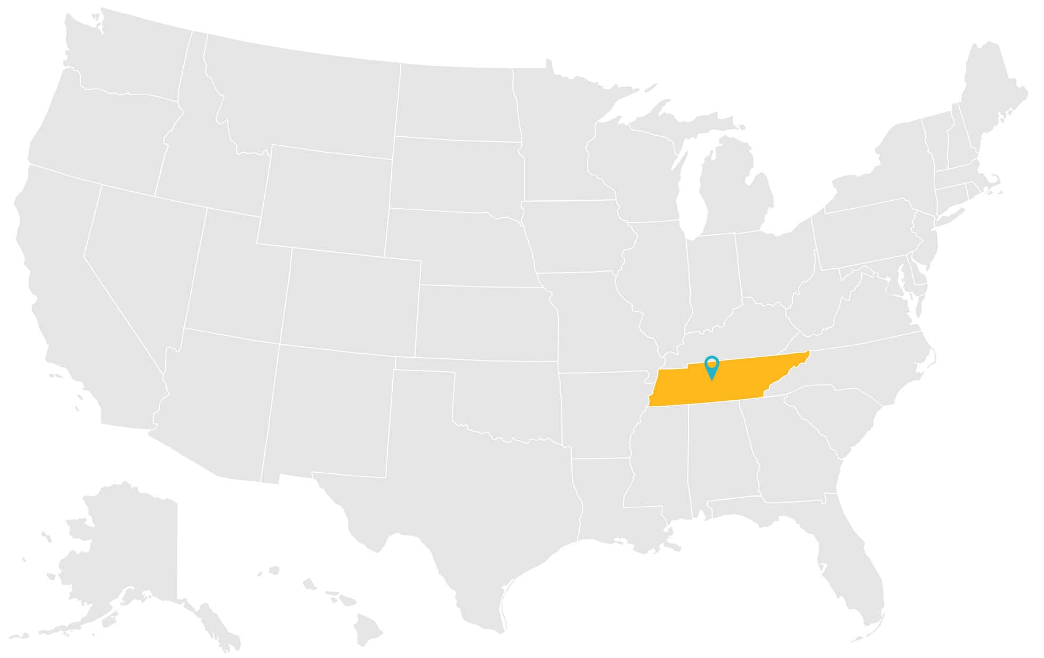
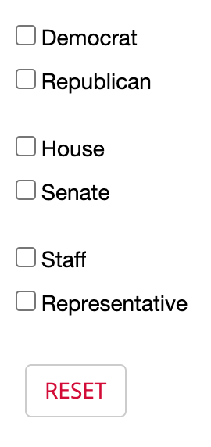
Total Meetings: 1

Slide 25
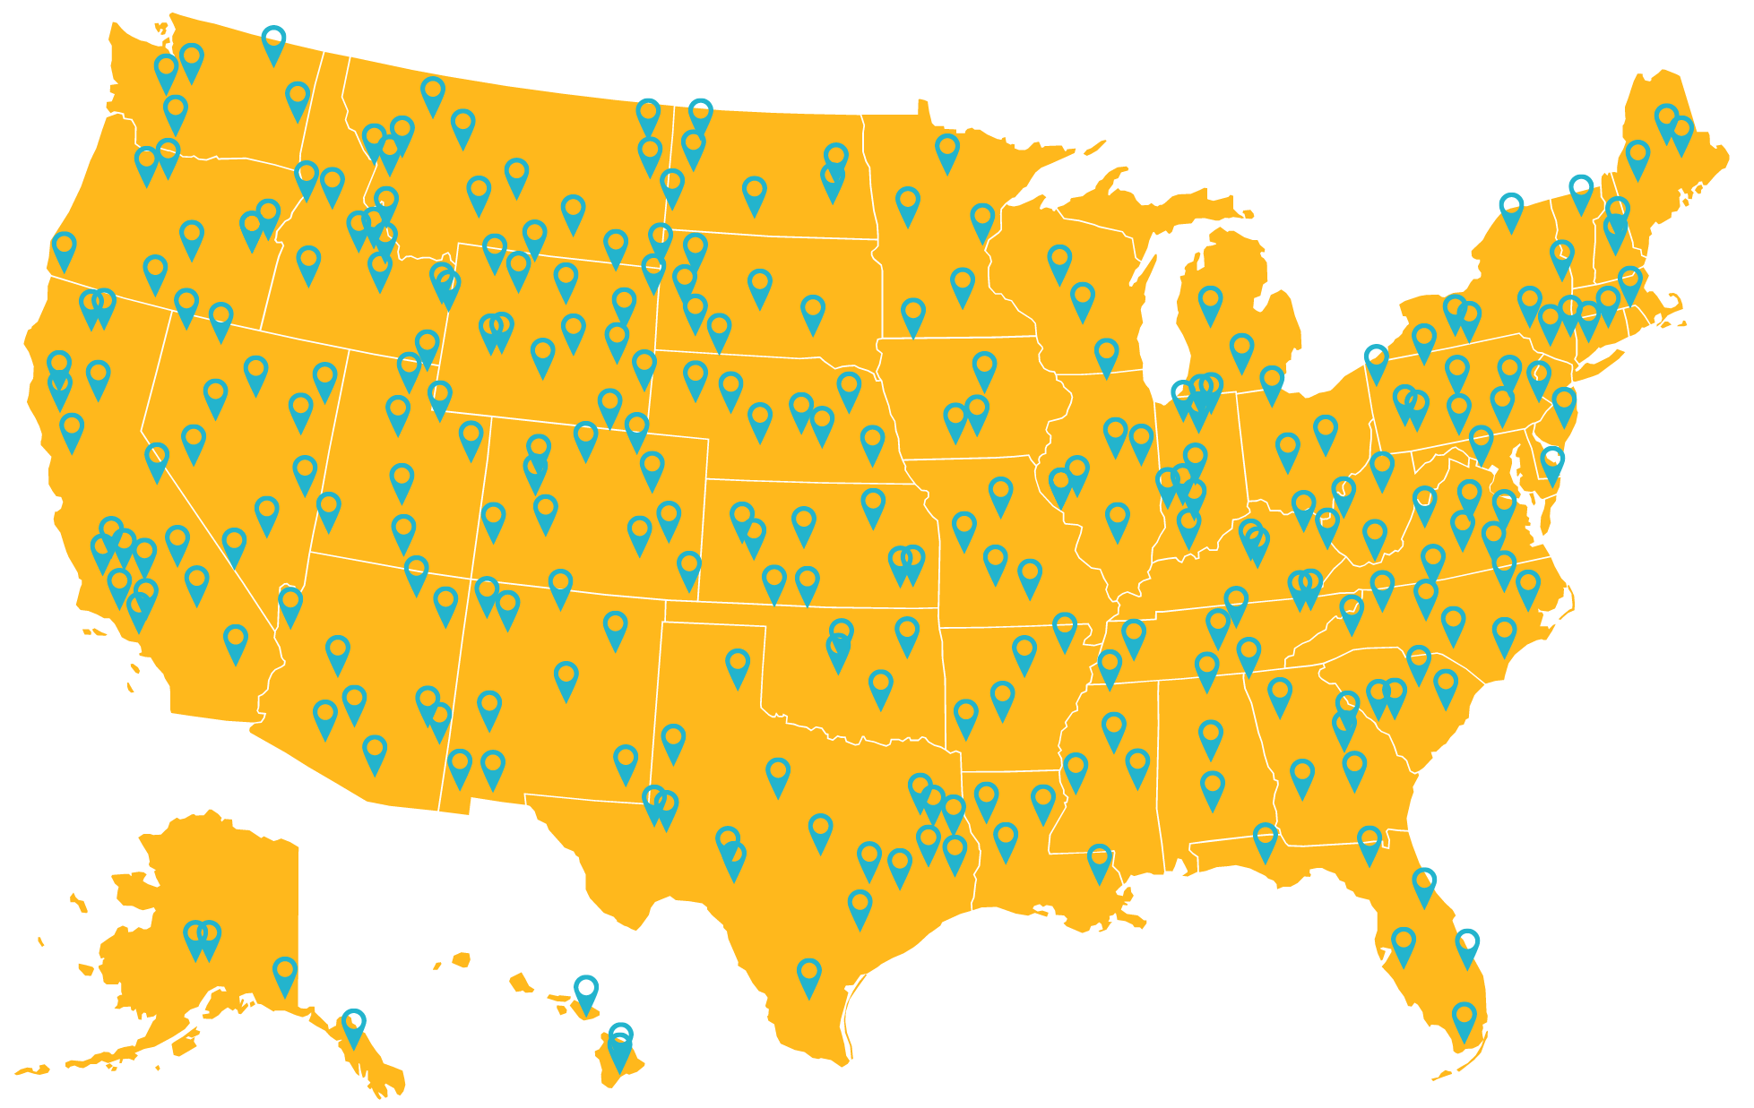

Total Meetings: 301

Slide 26
Looking Ahead:
First 100 Days Campaign
December: Group & Individual Planning
Through January: Growing the Movement
February: Kick-off Event on Saturday, February 6

Slide 27
February 6
First 100 Days Kickoff
Virtual Event
Register and get info on the campaign:
results.org/first100days

Slide 28
Outputs from this year
At least 20 LTEs published in 2020
At least 12 DFW advocates took part in at least 38 congressional meetings during the RESULTS IC. Those meetings mobilized 12 reps. and 3 senators to sign letters on a global COVID response
At least 35 DFW advocates have taken multiple online actions with 28 senators and 25 Representatives.
A similar number have made direct contact with congressional offices, developing relationships and influence with those offices.
Currently, 119 DFW Advocates have the potential to influence at least 72 Representatives, 56 senators
Notes:
If children are falling into poverty it’s because their mothers are falling into poverty.

Slide 29
What’s possible for next year
119 Advocates | 2020 | 2021 @ 50% | 2021 @ 100%
Letters to the Editor | 20 | 60 | 119
Meetings & relationships with senators and reps. | 38 | 35 Reps 28 Senators | 72 Reps 56 Senators
Advocates taking Online Actions | 35 | 60 | 119
What if we grow?
Notes:
If children are falling into poverty it’s because their mothers are falling into poverty.

Slide 30
Important Dates
Dec. 15 at 7 pm ET & Dec. 16 at 10 pm ET: DFW Advocacy Chapter with RESULTS
Please answer DFW advocacy survey your received
DFW Virtual Chapter Meetings. Find more info. here: https://diningforwomen.org/virtual-meetings/
Notes:
Leslye

