Slide 1
DFW Advocacy Chapter with RESULTS
October Webinar: COVID & Candidates
Oct. 20 & 21, 2020
Notes:
Leslye

Slide 2
Welcome New Advocates
Partnership between DFW and RESULTS
Welcome those who are new to the chapter
No advocacy experience required, but it does require us venturing outside our comfort zone to make a difference.
Let’s do this together!
Notes:
Leslye
Welcome newcomers and those who got started last month

Slide 3
Zoom Instructions
We want to hear from you, but please stay muted unless speaking. To unmute, click the microphone icon, dial *6 on the phone, or raise your hand so we can unmute you.
Also share comments and/or questions using the “Chat” icon
Notes:
Leslye

Slide 4
New Mission & Vision
DFW’s NEW MISSION
Dining for Women cultivates the collective power of community
to achieve global gender equality.
DFW’s OUR NEW VISION
Dining for Women envisions a world where every person
has the same opportunities to thrive
regardless of their gender or where they live.
Notes:
Leslye

Slide 5
Getting Connected
Ice Breaker
Share one word in the chat describing how you are feeling about the world right now? Share one word about how you feel about 2021.
Share anything you’re proud of accomplishing with the group or with your own advocacy.
Notes:
Leslye

Slide 6
Goals for Today
Review where we are on the COVID-19 relief efforts, success of our advocacy, actions
Learn how to engage congressional candidates to jumpstart relationship building for the new Congress
Help us improve our advocacy efforts
Notes:
Leslye

Slide 7
What are We Trying to Do
as Advocates?
We work in a non-partisan way to influence our decision makers in Congress, guiding them toward solutions that will positively impact the lives of women, girls, and children living in poverty.
Notes:
Leslye
Even members of Congress who seem to support these issues need to be contacted—they often don’t know about opportunities for action, or won’t take them unless they hear from constituents.

Slide 8
Assess where our members of Congress are on the Champion Scale, then move them up
What are We Trying to Do
as Advocates?
4 Champion
3 Leader
2 Advocate
1 Supporter
0 Uninformed or Neutral
-1 Opponent
Notes:
Leslye
Any move we make on the Champion Scale is a win. If they move from Opponent to silence, there is less opposition. If we move them from a supporter to advocating with another member of Congress, it is a win. We do this through relationship building.

Slide 9
2020 Campaigns
Improve maternal health and child survival:
Ensure the US is funding maternal & child health, child vaccinations, and child nutrition at robust levels for FY21 (In progress—unclear what will happen)
Ensure the US pledges to fund Gavi, the Vaccine Alliance’s 5-year work plan (Complete—successful!!)
COVID-19 RESPONSE: ADDED & in progress
Ensure that US and world leaders make serious commitments to end child malnutrition (pushed to 2021)
Notes:
Leslye

Slide 10
Why is DFW working on Covid?
The situation for women, girls, children is urgent.
“Around 435 million women and girls will be living on less than $1.90 a day by 2021, including 47 million pushed into poverty as a result of COVID-19, according to the new U.N. findings…Unless Congress acts, progress could be set back 10-20 years on AIDS, TB, malaria, vaccinations, maternal and child deaths, etc.”
--Article: Pandemic is widening poverty gap between women and men, new UN findings show, 9/2/20
Notes:
Leslye

Slide 11
Why is DFW working on Covid?
NY Times Article, 9/11/20: “The Other Way Covid Will Kill: Hunger. Worldwide, the population facing life-threatening levels of food insecurity is expected to double, to more than a quarter of a billion people.”
“We hear our children screaming in hunger, but there is nothing that we can do,” said Ms. Bibi, speaking in Pashto by telephone from a hospital in the capital city of Kabul, where her 6-year-old daughter was being treated for severe malnutrition. “That is not just our situation, but the reality for most of the families where we live.”
Notes:
Leslye

Slide 12
Why is DFW working on Covid?
“In only half a year, the coronavirus pandemic has wiped out decades of global development in everything from health to the economy. Progress has not only stopped, but has regressed in areas like getting people out of poverty and improving conditions for women and children around the world, the Bill and Melinda Gates Foundation finds in its 2020 Goalkeepers report published Monday…’In other words, we’ve been set back about 25 years in about 25 weeks,’ the report says. ‘What the world does in the next months matters a great deal.’
--Politico: 25 years wiped out in 25 weeks: Pandemic sets the world back decades. 9/14/20
Notes:
Leslye
What else can we say. Nothing else you could be working is more important. We are at the end of the 116th Congress. In January every bill, resolution, piece of legislation in progress is wiped out. Bills will start out with the #1. It is helpful to generate support on bills that might be reintroduced, but there is nothing more urgent now than getting money into programs like the ones we are advocating for.

Slide 13
Why is DFW working on Covid?
“These newly impoverished people are likely to be more women who work mostly in informal jobs in low- and middle-income countries. And the coronavirus's bad news for women doesn’t stop there.
“Indirectly, COVID will cause more women than men to suffer and die, in large part because the pandemic has disrupted health care before, during, and immediately after childbirth,” the report says. Newborns are at risk too, as more infants are likely to die when health systems falter — as is happening now around the world.”
--Politico: 25 years wiped out in 25 weeks: Pandemic sets the world back decades. 9/14/20
Notes:
Leslye

Slide 14
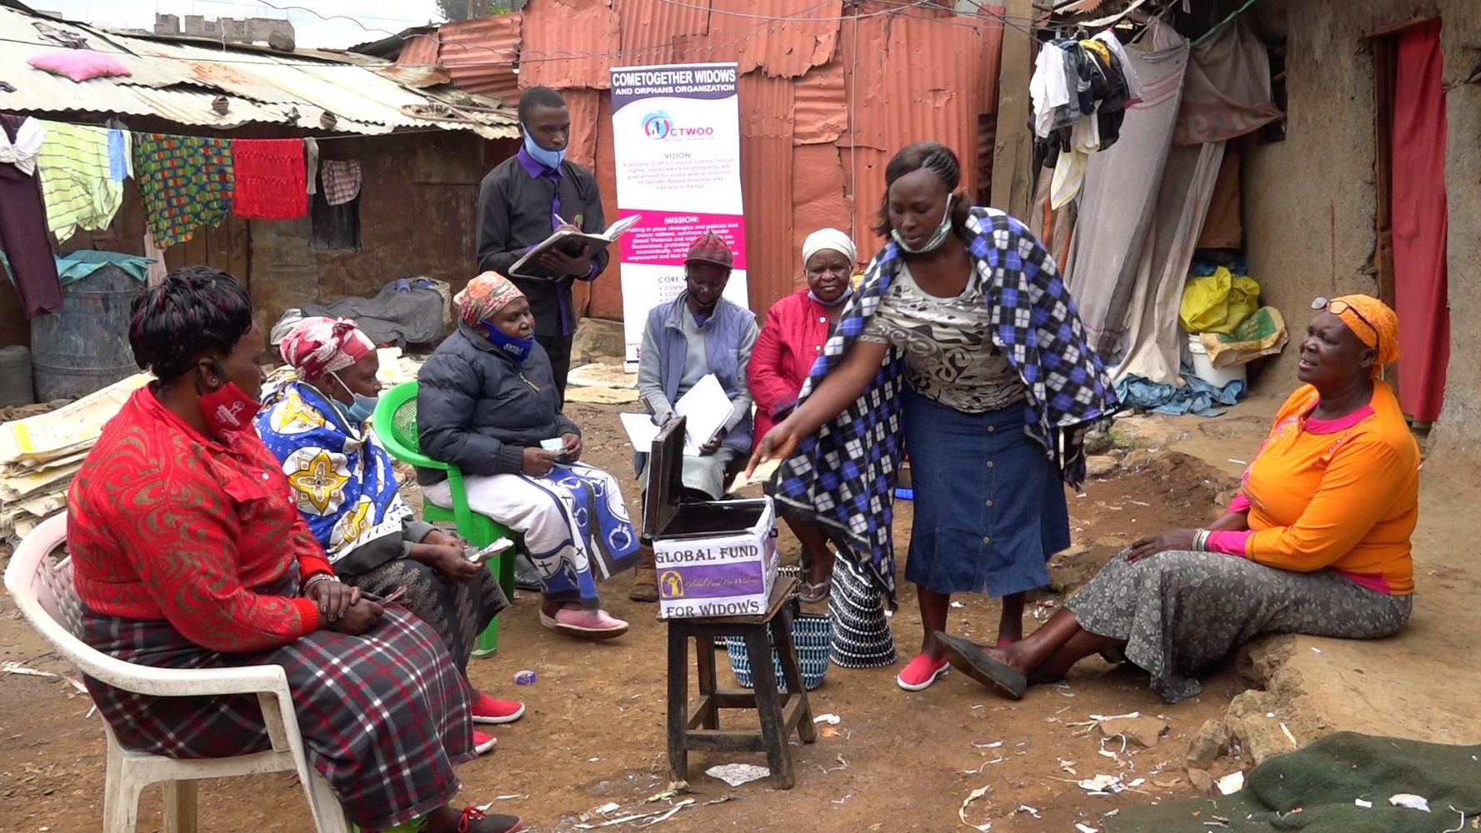
Global Fund for Widows - Kenya
DFW October Grantee
Our DFW Grantees are Advocates too!
At the Human Rights Council in Geneva, Switzerland and the Commission on the Status of Women in New York in both 2018 and 2019, Global Fund for Widows delivered an insightful intervention in its continuing exposure of the institutionalized and systemic violations of human rights endured by widows across the globe and the direct link of widowhood to poverty. UN Secretary General Antonio Guterres received GFW’s intervention, acknowledged the importance of sustaining widows and PLEDGED his support to widows and the issue of widowhood globally.
Notes:
Chris

Slide 15
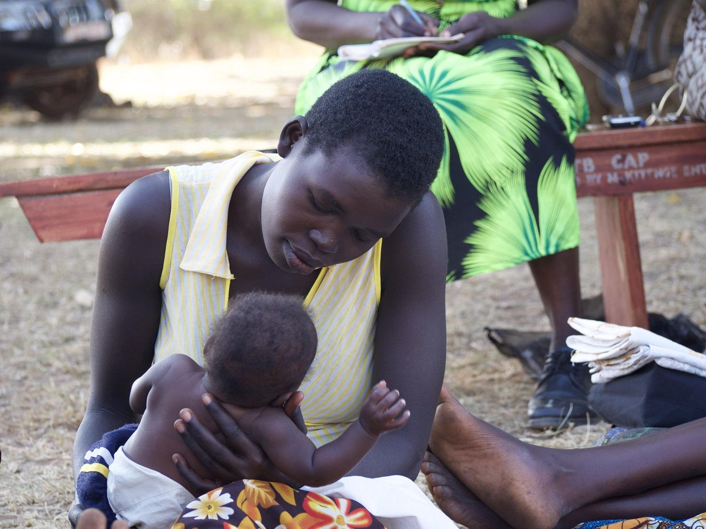
Dining for Women cultivates the collective power of community to achieve global gender equality.
According to a new analysis commissioned by UN Women and UNDP, by 2021 around 435 million women and girls will be living on less than $1.90 a day — including 47 million pushed into poverty as a result of COVID-19.
Gender poverty gaps will worsen as a result of the crisis. In 2021, it is expected there will be 118 women in poverty for every 100 poor men globally, and this ratio could rise to 121 poor women for every 100 poor men by 2030.
Without gender-responsive policies, the crisis risks derailing hard-won gains.
DFW October Sustained Grantee: HealthRight International Inc.
Program for Global Mental Health, Uganda
https://www.unwomen.org/-/media/headquarters/attachments/sections/library/publications/2020/gender-equality-in-the-wake-of-covid-19-en.pdf?la=en&vs=5142
Notes:
Chris

Slide 16
Where Are Things Now?
Government is funded through Dec. 11
No agreement between House, Senate, Administration on COVID-19 supplemental bill
Passage of HEROES Act 2.0 in the House that includes $10 billion for international development assistance
End of 116th Congress is coming
Notes:
Leslye

Slide 17
Advocacy Works
HEROES 1.0: $3.4 Trillion | HEROES 2.0: $2.2 Trillion
$0 Development Assistance | $10 B Development Assistance
What we were advocating for | What is in HEROES 2.0
$20 billion for development assistance $4 billion Gavi, the Vaccines Alliance $4 billion for the Global Fund $2 billion for hunger/famine relief | $10 billion for development assistance $3.5 billion for Gavi, the Vaccine Alliance $3.5 billion for the Global Fund $750 million for World Food Program
Notes:
Leslye

Slide 18
What got us here?
HEROES 1.0: $3.4 Trillion | HEROES 2.0: $2.2 Trillion
$0 Development Assistance | $10 B Development Assistance
Focus on the COVID supplemental
Persistence action taking
Deepening relationships with Congress
Notes:
Leslye
This is how advocacy works. Can you think of another way to successfully generate support worth $10 billion for the things that will impact women, girls, children?

Slide 19
Possible Outcomes on COVID Bill
Miracle: Agreement happens before election
Supplemental passes after elections—highly dependent on outcome of elections
Supplemental passes in January
Bottom Line: We need a bill to pass. Sooner is better.
Notes:
Leslye

Slide 20
Taking Action
Contact your members of Congress on a COVID bill
Get published on the need for a COVID bill with a global response. Ideas for hooks?
Reach out to candidates
Notes:
Leslye
We did training on the first 2. Do you have any questions about how to take either of these actions? Some folks have mentioned that they are bored with taking the same action? Should we go through how to spice things up a bit? Use the champion scale to choose new actions (find on our website): Ask if they’ve spoken to leadership, leadership across the aisle, would they write and oped? Speak during a campaign event about these needs? Speak in favor of international assistance for Covid? Send a note to the administration?
Getting published: what might you hook your letter to: Elections, Covid effects, voting, global connections, etc.

Slide 21
21
Why advocate around the election?
Establish early relationships
Inform/educate candidates
Educate the public
Set the agenda for next Congress
Talk to them when they are interested
Notes:
Examples
Met with candidate who was elected—led to starting a new group
Talk to them at a time when they really want/need to connect with constituents
January is chaotic, especially for newly elected members—hard to even find them
Staff are often carried over to the new offices—you’ll know them already

Slide 22
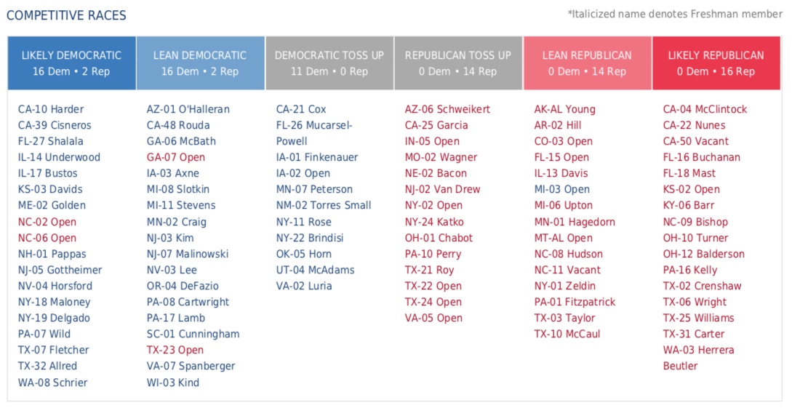
22
Why advocate around the election?
Notes:
Examples
Met with candidate who was elected—led to starting a new group
Talk to them at a time when they really want/need to connect with constituents
January is chaotic, especially for newly elected members—hard to even find them
Staff are often carried over to the new offices—you’ll know them already

Slide 23
23
Direct Advocacy: Public events, group meetings, one-on-one interactions
Set up a meeting with your group
Town halls (virtual or in-person)
Meet and greets and fundraisers
Working for the campaign
Candidate calls to voters

Slide 24
Creating Direct Advocacy Opportunities:
Find Events, Set Up a Meeting
24
Check website & contact campaign office or party headquarters for a meeting and/or ask when you can hear candidates speak.
Sign up for campaign updates on their campaign page. Campaign pages are separate from official government websites.
Follow candidates and local political parties on Twitter and Facebook
Donate to a campaign
Visit www.townhallproject.com (mainly current members of Congress)
Research their positions on the issues.

Slide 25
Preparing to Engage – What to say
25
Identify the issue(s) you want to highlight
Research candidate positions on the issues
  Campaign website, public statements, third-party ex. League of Women Voters
Draft your question(s) – keep brief; use EPIC format
  ENGAGE the listener in your conversation
  Identify the PROBLEM you want solved
  INFORM them of the solution (tell a story)
  Provide a detailed CALL TO ACTION (Yes/No question)
Coordinate with others to participate
  Increases chances of personal encounter with candidate
Practice, practice, practice

Slide 26
Online Town Hall & Meet and Greet Tips
26
Recruit others to participate and coordinate on questions you’ll ask
Arrive early to online event so you don’t miss any instructions.
Listen carefully to for how to ask questions.
  If they are taking live questions, get in the queue as early as possible
  If they are only taking written questions, submit them early.
If using video, don’t wear anything political
When called on, ask your question in a succinct, informative way
Follow-up with campaign staff
  Provide more details of issue and any materials
  If you don’t get a question asked, ask staffer to speak to candidate and then follow-up about the response

Slide 27
Prepare to Ask Questions & Listen: Group Meeting
27
Similar to a meeting with a MoC.
Engage other organizations if it helps set the meeting
Let them know who you are, who you represent in the community, history of the group, recent successes
Prepare laser talks and questions related to RESULTS issues
Listen and offer to provide more information on our issues
Let them know you want to work with them in the future
Take photo
Notes:
Depending on how long you have to speak, prepare to talk about RESULTS successes and history.

Slide 28
Sample EPIC Laser Talk: Global Poverty
28
Engage: A recent poll by the ONE Campaign confirms my sentiments that the US must also have a global response to this global pandemic. According to the poll, “nearly all voters say it is important for the U.S. to lead the world in responding (85%), preventing (86%), and detecting (85%) global infectious diseases.”
Problem: Projections are that, because of COVID-19, hard fought global health progress could be set back 10-20 years and millions of children and adults could die from lack of healthcare, malnutrition, and disease without additional resources.
Inform: But sustaining and increasing U.S. support to existing global health programs like Gavi, the Global Fund, and PEPFAR, as well as investing in food aid and nutrition, will make a difference now and in the longer-term.
Call to Action: US leadership has contributed to major advances on global health and poverty over the years. What role do you think the US should play in addressing global poverty and global health? And what will you do about these issues once elected?
Notes:
Depending on how long you have to speak, prepare to talk about RESULTS successes and history.

Slide 29
Working for Campaign or Candidate Calls
29
Always have your question(s) ready to go
  Take advantage of your opportunities when they come
Be polite and friendly
  Make sure you have a specific ask (could be policy position)
Plan to follow up as needed
  Check in on request, provide additional info, materials,
Talk to others about the issues you care about
  Good way to get others interested in your issues

Slide 30
Direct Advocacy
30
Questions?

Slide 31
Important Dates
Nov. 17 at 7 pm ET & Nov. 18 at 10 pm ET: DFW Advocacy Chapter with RESULTS
Survey coming your way
DFW Virtual Chapter Meetings. Find more info. here: https://diningforwomen.org/virtual-meetings/
Notes:
Leslye

