Slide 1
RISE Advocacy Chapter October Webinar
October 17, 2023
Notes:
Leslye

Slide 2
Welcome
Please let us know in the chat where you are joining us from!
Notes:
Leslye

Slide 3
Mission & Vision
Together Women Rise’s Mission
Together Women Rise cultivates the collective power of community to achieve global gender equality.
OUR VISION
Together Women Rise envisions a world where every person has the same opportunities to thrive regardless of their gender or where they live.
Notes:
Leslye

Slide 4
Our Values & Resources
​At RESULTS we pledge to create space for all voices, including those of us who are currently experiencing poverty. We will address oppressive behavior in our interactions, families, communities, work, and world. Our strength is rooted in our diversity of experiences, not in our assumptions.
With unearned privilege comes the responsibility to act so the burden to educate and change doesn’t fall solely on those experiencing oppression. When we miss the mark on our values, we will acknowledge our mistake, seek forgiveness, learn, and work together as a community to pursue equity.
Read our full anti-oppression values statement here at results.org/values.
Check out the 2023 Fall Anti-Oppression Workshop Schedule for training opportunities.
Find these resources and more at results.org/volunteers/anti-oppression:
Resource Guides from our Diversity & Inclusion trainings, including:
Interrupting Microaggressions
Creating Space for Critical Conversations
Information on how RESULTS responds to oppressive incidents
Notes:
Leslye

Slide 5
How have the events in the world affected you?
Notes:
Leslye

Slide 6
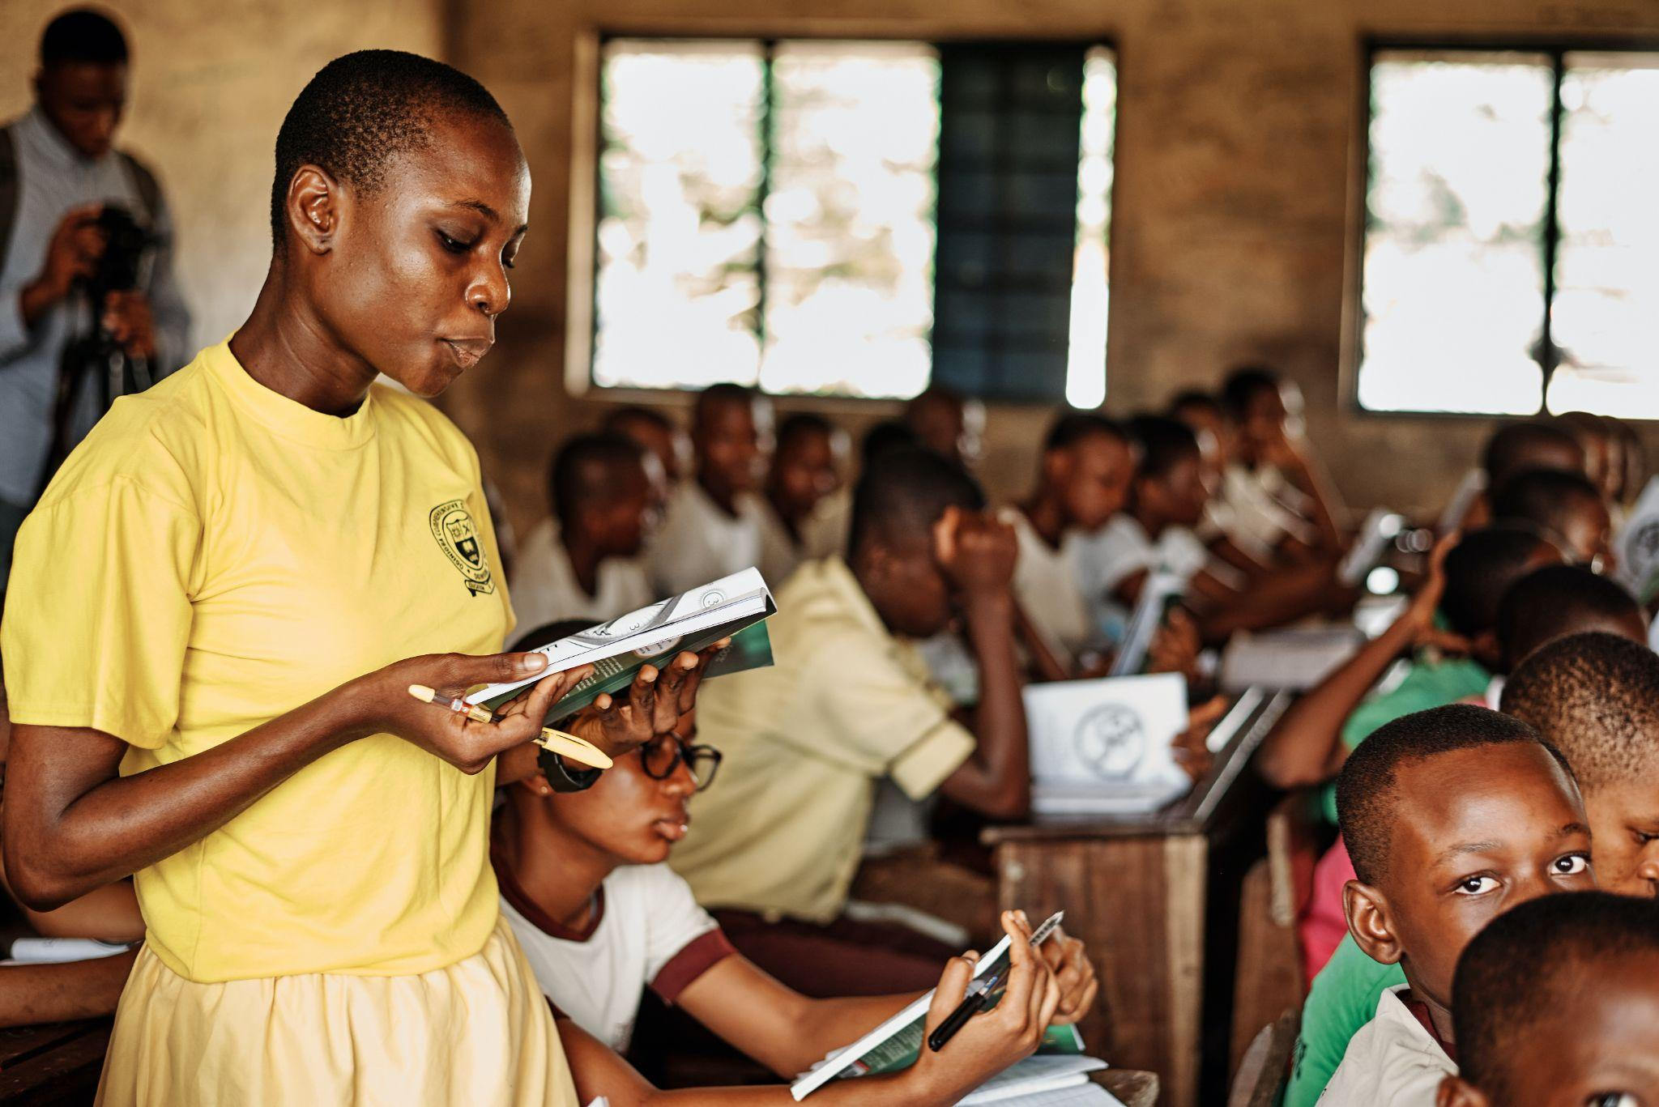
The READ Act:
Time is of the Essence!
Photo courtesy of Emmanuel Ikwuegbu, Unsplash.com
Notes:
Leslye

Slide 7
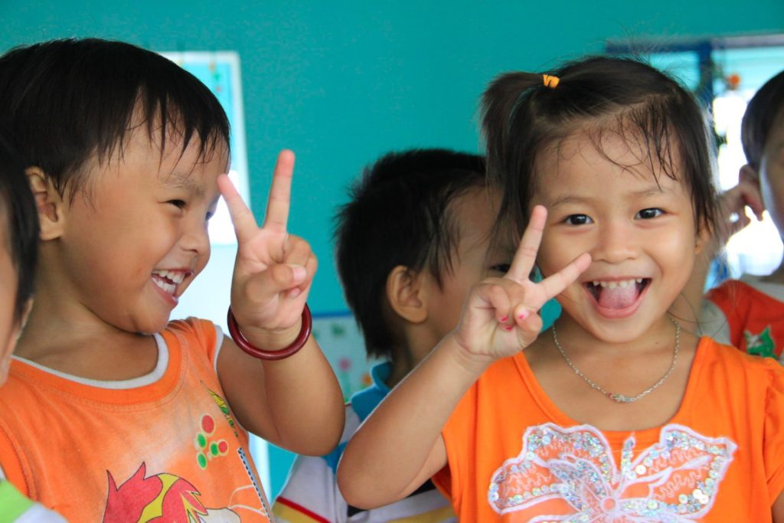
Grantee Spotlight
Children of Vietnam
Notes:
Margaret Video: https://youtu.be/fDXgZIcQeTs Project Title: Ending Female Genital Mutilation: A Three-Pillar Approach
Location: Kenya
Grant Amount: $48,000
Grantee Website: www.lastmile4d.org/
Areas of Impact: Education & Literacy, Gender Equality, Health
Mission of LastMile4D
LastMile4D’s mission is to mobilize resources to ensure that girls and women everywhere, particularly in remote communities, can access information about their rights to health, safety, and gain freedom from gender-based violence.
Project Summary
The purpose of this project is to end Female Genital Mutilation/Cutting (FGM/C) by educating, informing, and enlisting community-wide awareness and support.
Why We Love This Project
Last Mile4D uses a multi-pronged approach to create awareness and eradicate FGM/C in communities that are hard to reach and at the last mile. With the use of innovative technology, real-time monitoring of data, and crises intervention strategies, Last Mile4D has been very successful in sensitizing entire communities, increasing schooling levels among young girls, and advocating for the eradication of FGM/C.

Slide 8
Grantee Spotlight
Children of Vietnam
Grant Amount: $50,000 Mission of Children of Vietnam Changing the lives of impoverished, homeless and handicapped children in Vietnam by addressing the root causes of poverty for vulnerable populations including impoverished single mothers with dependent children.
Project Summary
EFWC is a special initiative to promote income sustainability for struggling single mothers. Together Women Rise will supports 200 women and 12,000 girls through EFWC that will work to develop personal empowerment plans to lift families out of poverty through training, microloans, healthcare and improved housing.
Notes:
Leslye Video: https://youtu.be/fDXgZIcQeTs Project Title: Ending Female Genital Mutilation: A Three-Pillar Approach
Location: Kenya
Grant Amount: $48,000
Grantee Website: www.lastmile4d.org/
Areas of Impact: Education & Literacy, Gender Equality, Health
Mission of LastMile4D
LastMile4D’s mission is to mobilize resources to ensure that girls and women everywhere, particularly in remote communities, can access information about their rights to health, safety, and gain freedom from gender-based violence.
Project Summary
The purpose of this project is to end Female Genital Mutilation/Cutting (FGM/C) by educating, informing, and enlisting community-wide awareness and support.
Why We Love This Project
Last Mile4D uses a multi-pronged approach to create awareness and eradicate FGM/C in communities that are hard to reach and at the last mile. With the use of innovative technology, real-time monitoring of data, and crises intervention strategies, Last Mile4D has been very successful in sensitizing entire communities, increasing schooling levels among young girls, and advocating for the eradication of FGM/C.

Slide 9
Grantee Spotlight
Children of Vietnam
Why We Love This Project
This is a powerful program with an individual approach as these women face a myriad of barriers that trap them in poverty. It requires a multi-faceted effort to confront the causes of poverty as a single solution often fails. EFWC will work collaboratively with each woman to develop an empowerment plan by assessing needs, identifying strengths and defining personal goals. Ultimate GOAL: for each mother to be in charge of her future and to earn a stable income that sustains the family. This organization was last funded in 2009 for $26,947.25, in 2012 for $30,049, and in 2013 for $30,049 for a total of $87,045.
Notes:
Grantee Spotlight (Pat payne) Girls Rising in Pakistan - https://www.girlrising.org/pakistan
Girl Rising is receiving a grant of $50,000 to fund a project called "Kaavish: Girl Rising in Pakistan".
Girl Rising - Together Women Rise
Adolescent girls are at the heart of gender-based inequity in education. This project provides training to teachers and administrators, provides financial support to girls and parents, and includes mental health and menstrual health in the curriculum. Girl Rising advocates for continued schooling of girls by changing attitudes and social norms around girls' education, child marriage and marital violence. The grant is $50,000 over 2 years.
Project Title: Kaavish: Girl Rising in Pakistan
Location: Pakistan
Grant Amount: $50,000 over 2 years
Grantee Website: girlrising.org/
Areas of Impact: Education & Literacy, Gender Equality
Mission of Girl Rising
Girl Rising’s mission is to use the power of storytelling to change the way the world values girls and their education.
Project Summary
This project provides adolescents, educators, parents, and community members with the resources, training, and skills to improve education quality, remove education barriers, and create new advocates for gender equality.
Why We Love This Project
Adolescent girls are at the heart of the gender-based inequity in education. We love Girl Rising’s targeted focus on girls who live and study in environments that are hostile to their schooling and development. This project provides training and mentoring to teachers and school administrators, provides financial support to adolescent girls and parents, and facilitates the inclusion of menstrual health and mental health to the curriculum. Girl Rising also energizes entire communities to advocate for the continued schooling of girls by changing attitudes and social norms around girls' education, child marriage, and marital violence.
Note: there is no video posted yet but Girl Rising website has a revolving slideshow on home page

Slide 10
Grantee Spotlight
Growth Through Learning
Notes:
Margaret Video: https://youtu.be/fDXgZIcQeTs Project Title: Ending Female Genital Mutilation: A Three-Pillar Approach
Location: Kenya
Grant Amount: $48,000
Grantee Website: www.lastmile4d.org/
Areas of Impact: Education & Literacy, Gender Equality, Health
Mission of LastMile4D
LastMile4D’s mission is to mobilize resources to ensure that girls and women everywhere, particularly in remote communities, can access information about their rights to health, safety, and gain freedom from gender-based violence.
Project Summary
The purpose of this project is to end Female Genital Mutilation/Cutting (FGM/C) by educating, informing, and enlisting community-wide awareness and support.
Why We Love This Project
Last Mile4D uses a multi-pronged approach to create awareness and eradicate FGM/C in communities that are hard to reach and at the last mile. With the use of innovative technology, real-time monitoring of data, and crises intervention strategies, Last Mile4D has been very successful in sensitizing entire communities, increasing schooling levels among young girls, and advocating for the eradication of FGM/C.

Slide 11
Grantee Spotlight
Growth Through Learning
Grant Amount: $25,000 Mission of Children of Vietnam To provide and enhance educational opportunities by offering scholarship aid to deserving East African girls and young women. In addition, the organization encourages a cross-cultural exchange of information and ideas between countries.
Project Summary
Growth Through Learning (GTL) provides educational scholarships for the girls and young women of East Africa, many of whom are orphans. The average cost to provide a scholarship is $600/year. This amount keeps a young girl in school by funding school fees, uniforms, food, books and supplies. A girl learns how to read and write in both English and her native language and obtains the skills necessary to teach her own children how to add and subtract, understand ideas and strive for a better future.
Notes:
Leslye Video: https://youtu.be/fDXgZIcQeTs Project Title: Ending Female Genital Mutilation: A Three-Pillar Approach
Location: Kenya
Grant Amount: $48,000
Grantee Website: www.lastmile4d.org/
Areas of Impact: Education & Literacy, Gender Equality, Health
Mission of LastMile4D
LastMile4D’s mission is to mobilize resources to ensure that girls and women everywhere, particularly in remote communities, can access information about their rights to health, safety, and gain freedom from gender-based violence.
Project Summary
The purpose of this project is to end Female Genital Mutilation/Cutting (FGM/C) by educating, informing, and enlisting community-wide awareness and support.
Why We Love This Project
Last Mile4D uses a multi-pronged approach to create awareness and eradicate FGM/C in communities that are hard to reach and at the last mile. With the use of innovative technology, real-time monitoring of data, and crises intervention strategies, Last Mile4D has been very successful in sensitizing entire communities, increasing schooling levels among young girls, and advocating for the eradication of FGM/C.

Slide 12
Grantee Spotlight
Growth Through Learning
Why We Love This Project
GTL's history resembles Together Women Rise, and their values are in line with our reasons to give internationally. What started as a tiny organization that Whiting ran out of his home grew into an established charity, with an all-volunteer board of directors and an endowment to help cover overhead costs and scholarship coordinators in Tanzania, Kenya and Uganda. GTL has moved from Whiting's living room to an office in Worcester, MA, and now has a paid staff. All Whiting asks of the scholarship recipients in return is that they write a letter, letting him know how they are progressing. He was surprised by how many recipients called themselves his daughters. This organization was last funded in 2006 for $5,500, in 2007 for $8,274, and in 2008 for $12,660 for total $26,434.
Notes:
Grantee Spotlight (Pat payne) Girls Rising in Pakistan - https://www.girlrising.org/pakistan
Girl Rising is receiving a grant of $50,000 to fund a project called "Kaavish: Girl Rising in Pakistan".
Girl Rising - Together Women Rise
Adolescent girls are at the heart of gender-based inequity in education. This project provides training to teachers and administrators, provides financial support to girls and parents, and includes mental health and menstrual health in the curriculum. Girl Rising advocates for continued schooling of girls by changing attitudes and social norms around girls' education, child marriage and marital violence. The grant is $50,000 over 2 years.
Project Title: Kaavish: Girl Rising in Pakistan
Location: Pakistan
Grant Amount: $50,000 over 2 years
Grantee Website: girlrising.org/
Areas of Impact: Education & Literacy, Gender Equality
Mission of Girl Rising
Girl Rising’s mission is to use the power of storytelling to change the way the world values girls and their education.
Project Summary
This project provides adolescents, educators, parents, and community members with the resources, training, and skills to improve education quality, remove education barriers, and create new advocates for gender equality.
Why We Love This Project
Adolescent girls are at the heart of the gender-based inequity in education. We love Girl Rising’s targeted focus on girls who live and study in environments that are hostile to their schooling and development. This project provides training and mentoring to teachers and school administrators, provides financial support to adolescent girls and parents, and facilitates the inclusion of menstrual health and mental health to the curriculum. Girl Rising also energizes entire communities to advocate for the continued schooling of girls by changing attitudes and social norms around girls' education, child marriage, and marital violence.
Note: there is no video posted yet but Girl Rising website has a revolving slideshow on home page

Slide 13
Global policy
Our Fall Goal
Congress prioritizes equity and impact in the fight against global poverty
Notes:
Ken

Slide 14
Equity & Impact
Who does it reach? Who gets left out?
Are we working in partnership?
How is funding delivered?
Are interventions based on evidence?
Notes:
Ken

Slide 15
Part 1
How the U.S. government spends money and designs programs
Part 2
How the World Bank spends money and designs programs
Notes:
Ken

Slide 16
Global Advocacy Campaigns
Malnutrition Prevention & Treatment Act
The End Tuberculosis Now Act
The READ Act
Notes:
Ken

Slide 17
What's going on in this House?!?
Congressional Updates
Notes:
Ken

Slide 18
Asks on TB Right Now
Ask Reps and Senators to cosponsor the End TB Now Act and speak to House/Senate leadership about passing it ASAP.
Tip: Leverage your work on the House and Senate TB sign-on letters:
Share final letter and thank those who signed. Ask them to cosponsor End TB Now Act and speak to leadership.
Share final letter with those who didn't sign as well and let them know they can still make a difference on TB by cosponsoring the End TB Now Act.
Notes:
Ken

Slide 19
Asks on READ Act Now
READ in the House: Ask Reps. to cosponsor the READ Act and speak to Foreign Affairs leadership (McCaul, Meeks) about moving the bill out of committee ASAP.
READ in the Senate: Ask Senators to cosponsor READ Act and speak to Senate leadership about passing it ASAP.
Notes:
Ken

Slide 20
Advocacy Action: Media Push for Global Education
Notes:
Karyne

Slide 21
Why we use media?
Making connections between the issues we advocate on and current events
Bringing awareness of these issues to our community (more constituents)
Puts pressure on MOCs to act (they monitor what is being said about them in the media)
Notes:
Karyne

Slide 22
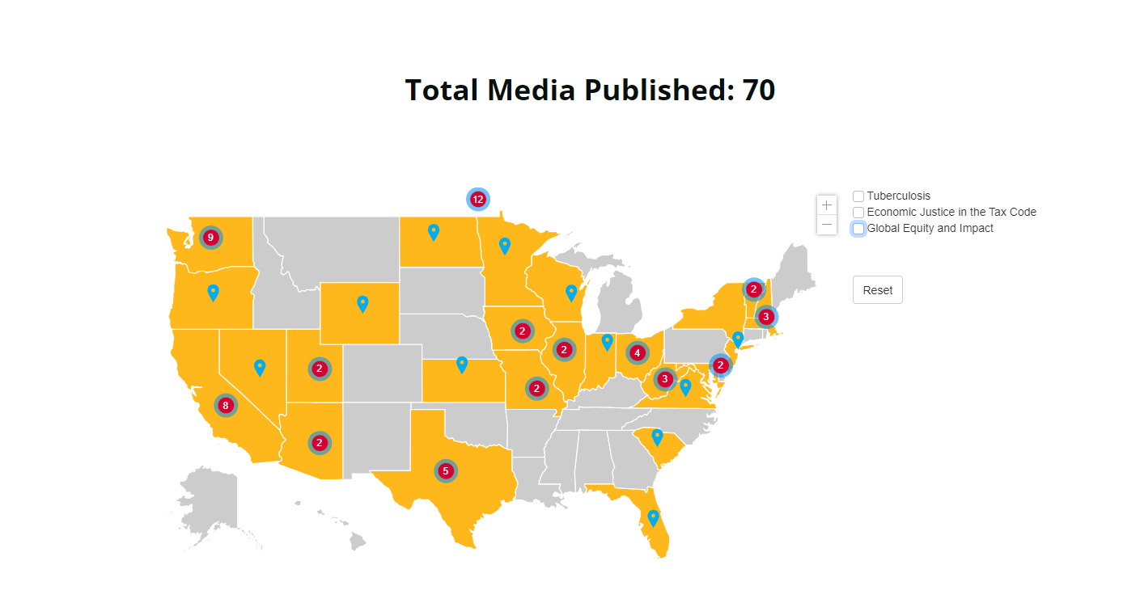

Slide 23
Recently Published LTEs
Notes:
Karyne
Recently Published Media – Link to all media: https://results.org/wp-content/uploads/RESULTS-Global-Poverty-Media-Packet-current-2023.pdf
Letter: Millions missing out on education - https://www.havasunews.com/opinion/letter-millions-missing-out-on-education/article_06cbad1e-58ce-11ee-b5d4-9b1beaaccde2.html
Global education crisis is a problem America can help fix - https://chicago.suntimes.com/2023/9/20/23880500/global-education-unesco-children-no-cash-bail-joe-biden-donald-trump-age-letters
Letter: US must continue to support global education - https://www.berkshireeagle.com/opinion/letters_to_editor/letter-us-must-continue-to-support-global-education/article_8a7b0bb8-272e-11ee-9171-0ba765f82ca8.html
US must lead on global ed - https://www.masslive.com/opinion/2023/09/springfield-renters-deserve-say-on-housing-problems-letters-to-the-republican.html
times west virginian - https://www.timeswv.com/opinion/readers_write/children-need-congress-to-pass-the-read-reauthorization-act/article_8d198400-5ca6-11ee-a8ba-974b805319e1.html

Slide 24
How do you get started?

Slide 25
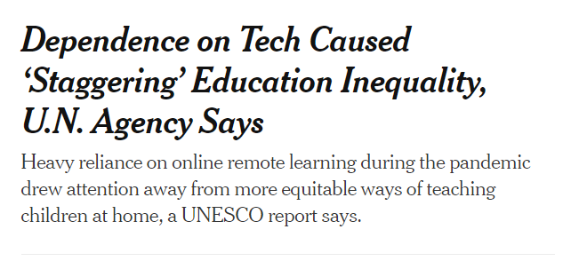
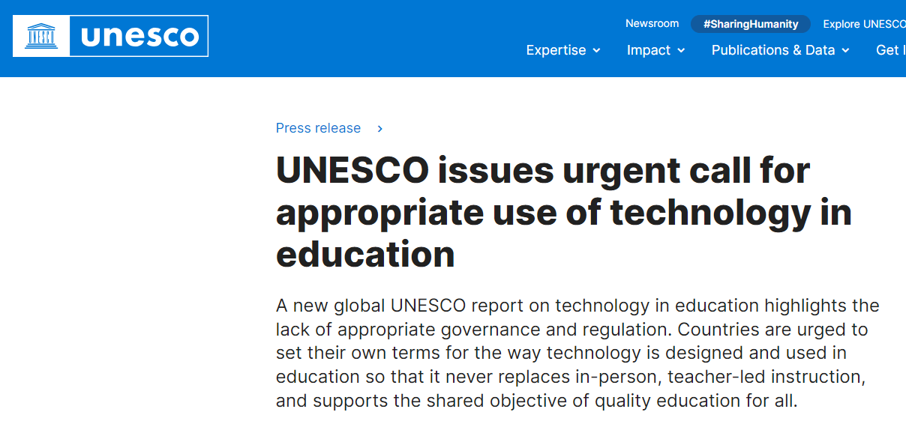
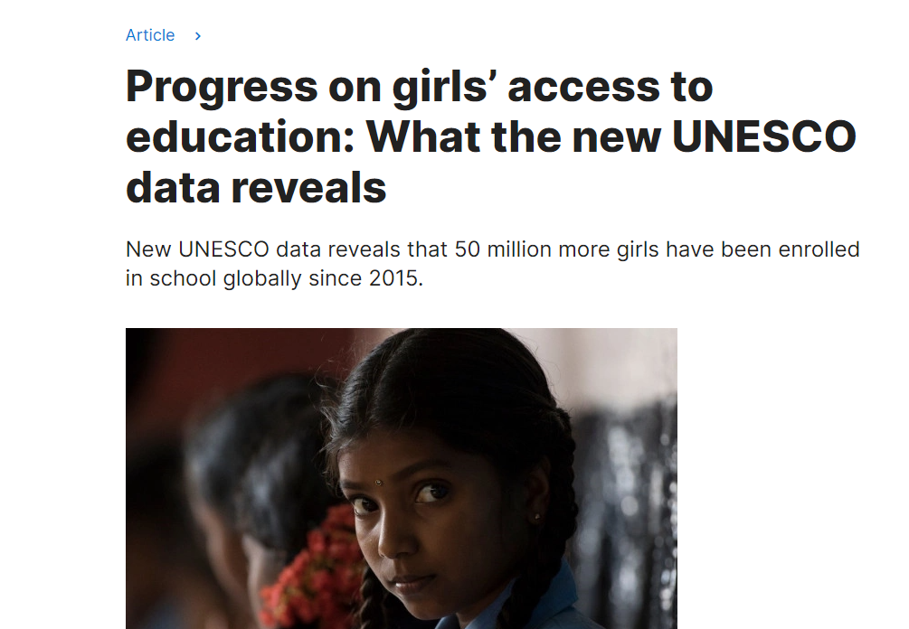
How do you get started?
Notes:
Karyne
Can we think about some hooks?
UNESCO - Progress on girls’ access to education - https://www.unesco.org/en/articles/progress-girls-access-education-what-new-unesco-data-reveals
Dependence on Tech Caused ‘Staggering’ Education Inequality, U.N. Agency Says - https://www.nytimes.com/2023/09/06/technology/unesco-report-remote-learning-inequity.html
WVO Abandons Award-winning Global Edu Program - https://www.insidehighered.com/opinion/views/2023/09/21/wvu-abandons-award-winning-global-education-opinion
UNESCO Appropriate use of technology - https://www.unesco.org/en/articles/unesco-issues-urgent-call-appropriate-use-technology-education
Lost in a world of words, Boston Globe article - https://apps.bostonglobe.com/metro/2023/10/literacy-education-strategies/

Slide 26
How do you get started?
Find a local hook
Articles in the paper?
•Respond to other published media (making connection to other health issues)
•Thank you to your Rep
•Use sample LTE template to get you started, make it personal

Slide 27
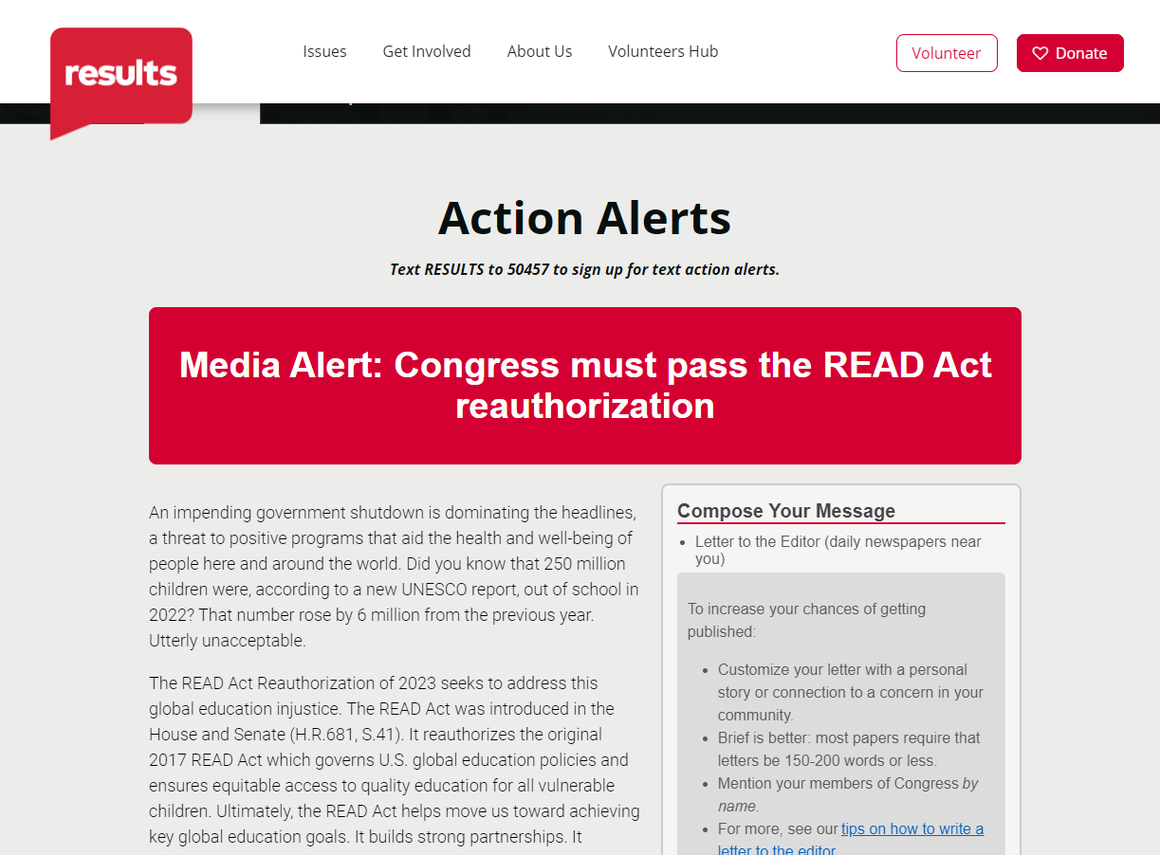
Submitting an LTE
https://results.org/volunteers/action-center/action-alerts?vvsrc=%2fcampaigns%2f87023%2frespond

Slide 28
No November webinar (thank you and enjoy your holiday break!)
Next webinar: Tuesday, December 12 at 8:30 PM ET Guest Speaker, Colin Puzo Smith, RESULTS Global Policy
November Grantee
If you would like to learn more about RISE grantees, there are chapters across the US, as well as a virtual national chapter meeting with a speaker from the grantee each month on the first Thursday of the month at 8 PM ET: https://togetherwomenrise.org/upcoming-events/
Closing
Notes:
Leslye Sign up for the Advocacy Chapter

Slide 29
Thank you for joining us tonight!

