Slide 1
Build the Movement Nuts and Bolts of Supporting New Advocates
September 28th, 2022 | 8:00 pm ET

Slide 2
welcome!
2
Please post your name, pronouns, and where you're joining from in the chat!
We will be getting started shortly...

Slide 3
our objectives
Prepare you to welcome, guide, and support new advocates
Redefine how we look at "success" in recruitment & outreach
Provide clarity for new advocate mentors about the role
Cultivate a “community of practice”

Slide 4
our facilitators
Sarah Leone
Alicia Stromberg

Slide 5
special guests
Cat Schoessler, Action Network Manager and New Advocate Mentor from RESULTS Anchorage
Kazmyn Ramos, Co-Group Leader & New Advocate Mentor from RESULTS Indiana

Slide 6
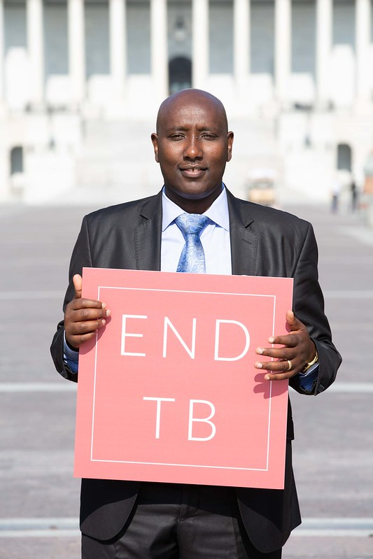
introductions
Name
City/State
1 thing you're hoping to learn today

Slide 7
7
Commitment is a JOURNEY
(not a single action)

Slide 8
Get updates on Campaign
Take a quick or online action (1 action)
Join our Action Network
(regular action)
Become a leader
Attend an action event with our group
Join our team -Be a Volunteer
Small Steps → Big Results
Build Power
Mobilize your Following
Create a Following
Notes:
Commitment is a journey
You might be starting at the first step – or in the middle – you have to meet people where they are, get them on the journey
Even if you only get someone to sign up for updates on RESULTS website – we will send them a ‘welcome series’ to help them learn more about RESULTS and take them down the commitment journey

Slide 9
Best Practices
Commitment is a PROCESS and not all volunteers will be ready to jump in and be a full-time group member. Success comes in many forms!
New advocates join with an understanding of who RESULTS is and what we do, and receive “hands on” training in local groups
ACTIVE & CONSISTENT communication is necessary

Slide 10
Best Practices, con’t
New Advocate Mentors = new advocate success. New volunteers need clarity on who to go to with questions
Inclusive and welcoming group meetings → slow down, ask them to participate, do the work DURING your meeting
Show, don’t tell (get them into action!)

Slide 11
Let’s hear from Cat, Kazmyn, and Sarah!

Slide 12
How has your experience been supporting new advocates? When have you been successful? What has been most challenging?

Slide 13
what's next?
Opportunities for New Advocate Mentors to do expansion follow-up are coming this fall
We're here to support you!
Sarah = mentors, group leaders, RCs
Alicia = onboarding, mentors
Community of practice
Join our RESULTS New Advocate Mentor listserv by emailing results-new-advocate-mentors@googlegroups.com
Will meet again in a few months!

