Slide 1
Action Network Monthly Webinar
May 19th, 2021

Slide 2
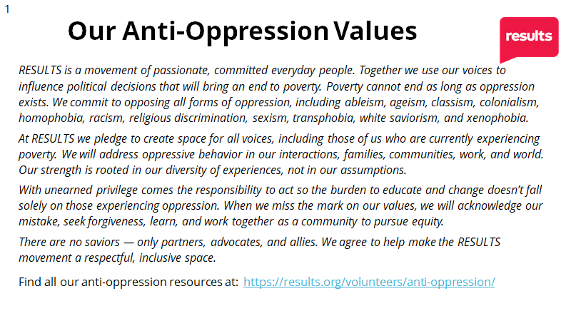

Agenda
Introductions: We have some

Slide 3
Agenda
Intros + Welcoming Newcomers!
Discussion: How are your Action Networks doing since we last met?
RESULTS Website – Accessing resources
June Planning -- Do you want a meeting & Action Alerts in June? Advocacy fatigue is real!
Action Alert
Announcements

Slide 4
Welcome to any new advocates!

Slide 5

How are you and your networks?

Slide 6
Accessing Action Network Resources
Currently two spots on the website under the Current Volunteers tab with Action Network Resources:
Working with the Community tab
Outreach & Planning tab
Notes:
So far, you've been receiving resources from me via our AN Community Listserv – I'm going to continue to do that, but I'm also in the process of updating the RESULTS Website to streamline it.

Slide 7
Planning for June 2021 (Poll)

Slide 8
Action Alerts – Your Thoughts!
Action Network Community Listserve is where the Action Alerts are being posted every two weeks
Have you liked the way they're being sent out?
  Have I been sending enough information or TOO much?

Slide 9
Announcements

Slide 10
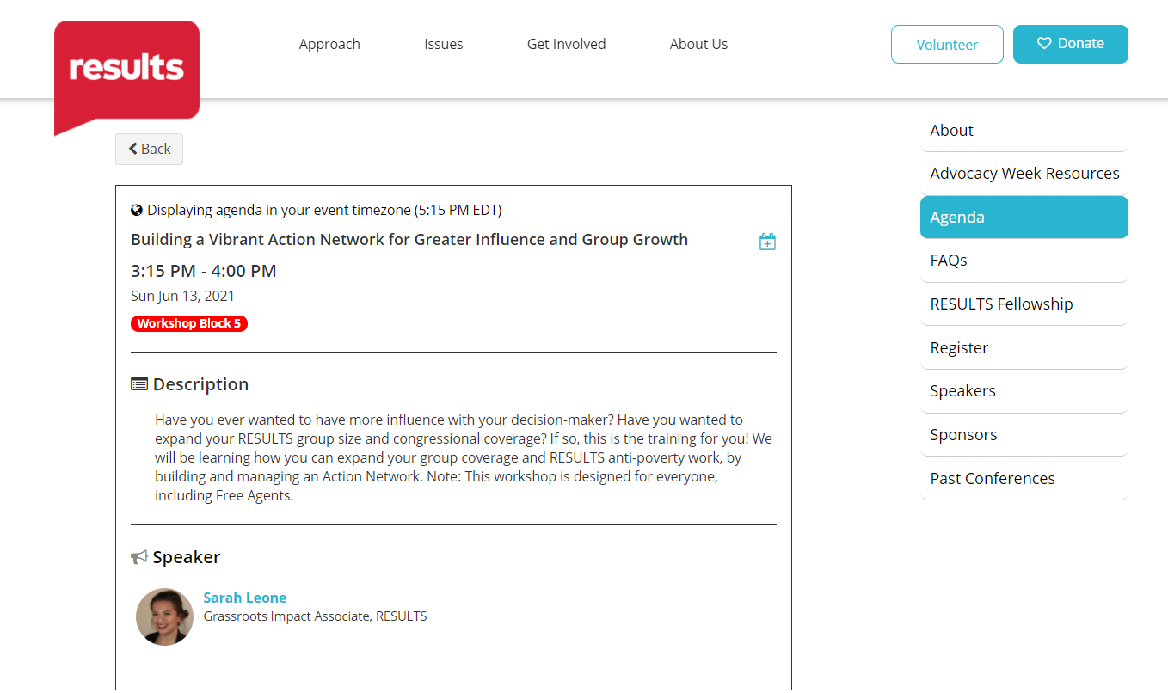
Action Networks will be represented at the International Conference!

Slide 11
Highlighting our Managers
I feel there is a need for our newer managers to hear from our veterans who have been doing this for years.
If you are someone who has an up and running Action Network and would love to share your expertise, please send me an email and we'll get you on the calendar!

Slide 12
Upcoming Action Alert & Webinar
Next Action Alert will be May 26th, 2021, via the Action Network Listserv
Dependent upon how you all vote – Next Webinar will be June 30th, 2021, at 8:30 pm ET
Please let me know if you would like to sign up to receive Action Alert and Webinar reminders via text!

Slide 13
Have a wonderful night, until next time!

