Slide 1
How to Build Your Action Networks 101
March 31st, 2021

Slide 2
RESULTS Believes
The end of poverty is possible and achievable. Political will is lacking.
Poverty is driven by oppression. RESULTS opposes all forms of oppression.
Government has an important role to play in ending poverty. Elected officials work for us. We need to supervise them.
Poverty is not partisan.
Nobody should be denied their basic rights to healthcare, education, or economic opportunity.
results.org/our-anti-oppression-values/

Slide 3
Agenda
Quiz
Action Networks
What are they?
Why are they important?
How do you build one?
Action Alerts
How do I manage my Action Network
Action Network Manager role
Role Play (if time permits)
Discussion & Next Steps

Slide 4
QUIZ TIME

Slide 5
What are Action Networks?
A local group of committed action takers who regularly take action on our issues (domestic and global)
Not just a mailing list!
May not be able to join the group

Slide 6
Why are they important?
To engage people who are interested in RESULTS but aren’t choosing to commit to full advocate status
To expand your group’s impact
To create an active pipeline of new activists
Action Networks cultivate leadership, exercise leverage, empower advocacy, and aid group expansion

Slide 7
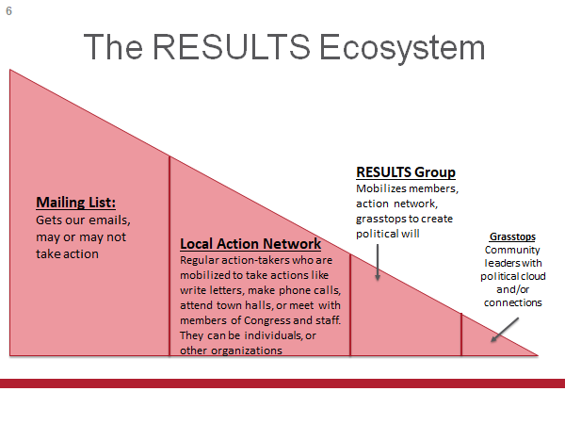

Slide 8
How do you build one?

Slide 9
Where do you find interested people?
Youth Organizations
Community Centers
Local Urban League
Food Pantries/Soup Kitchens
Faith/Interfaith Groups
Legislative Coalitions (Sarah’s example)
Ways to reach these people, and more:
Tabling at community events and Conferences (with COVID-19 still rampant, be careful, this will probably be used the least UNLESS the event is virtual, overall just use good judgement)
Networking with friends, family, colleagues, other associates (you may already have unofficial action networks, use that as a foundation to be empowered to reach out to others)
SOCIAL MEDIA!

Slide 10
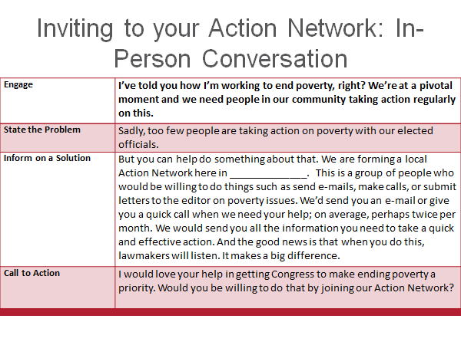

Slide 11
The Process of the Action Alerts
The Action Network managers(s) would receive the Action Network alerts from Sarah Leone via email
One email every two weeks!
From there, utilize whatever medium you want to disperse that information to your action network.

Slide 12
The Process (part two)
The members contact information of the Action Network stays confidential with whoever is the Action Network manager(s) and/or Group leader(s).
They won’t receive anything regarding donations UNLESS the individual Action Network member (from your list) wants to donate or sign up as a donor on the website.

Slide 13
Example of Communicating with Your Action Networks
Jennie Vano – Group Leader of the Tacoma, Washington group
https://www.youtube.com/watch?v=hwZA6DRTcIQ&ab_channel=ResultsTacoma
Ann Erdmann – Group Leader of the Cheyenne, Wyoming group
Contacting members from Mailchimp – does it work?

Slide 14
How do I manage my Action Network?
Keep a spreadsheet (Excel, Google Sheets, etc.) of your Action Network members
Keep this list private, only the Group Leader and the Action Network Manager should have access
Resources
Private Facebook group
Listserve (Google group)
Mailchimp
Any other ideas you have, just be organized!
Dedicated Action Network Manager

Slide 15
Who is the Action Network Manager?
Member of a RESULTS group (or Free Agent) that oversee the email and phone list of people who aren’t able to be part of your local group, but have agreed to write letters, take online actions, sign petitions, write letters to the editor, etc.
The Action Network Manager will monitor the list as it grows.

Slide 16
What does an Action Network manager do?
Stay connected with your group leader and activists in your group so that you are a bridge between action-taking and the network
Participate in monthly Action Network Community in Practice support call
Make phone calls to action network members after emailing them an action.
Even if you call a few each time, their desire to partake in advocacy will grow with a personal invitation
Provide feedback back to the members on the actions they have taken —“10 of you took action which made a real impression on the representative.”
Being creative on how to build action in this group. This is potentially a great pipeline into becoming partners

Slide 17
Identifying your Action Network Manager
What does it look like to ask an advocate with identifiable leadership skills if they would like to be the groups AN Manager?
As Group Leaders, don't take this project on by yourself, this is a great way to expand leadership within your group
This can help empower your advocates to want to be more involved
Opportunity to shine a light on their accomplishments within their advocacy
Opportunity for shared leadership (two advocates can be co-managers).

Slide 18
Ongoing Support for Action Network Manager
Please attend our newly reinstated Action Network - Community of Practice webinars will be once a month starting on April 14th, 2021
We will be reviewing the action alerts for the month as well as to cultivate ideas and troubleshoot dilemmas.
Reviewing mediums for managing Action Networks (i.e., Facebook groups, Mailchimp, Listserve, GroupMe, etc

Slide 19
Role Play! To access the script, click here.

Slide 20
Discussion

Slide 21
Next Steps
Community of Practice Monthly Webinars for Action Networks on April 14th, 2021 at 8:30 pm ET.
I will be emailing out the registration link in the coming weeks and it will also be available here on the Results events page.
Please know that I am here to help answer any questions you have, and we will work together to find a solution!

Slide 22
Contact information: Sarah Leone, BSW sleone@results.org

