Slide 1
Motivational Interviewing
RESULTS Webinar Session 1
Presented by
David Christian, Ph.D.

Slide 2
Ph.D. Utah State University
1992- Psychology Faculty, University of Idaho
1998- Clinical Practice, Logan, UT
MI Trainings since 1992
Leader, CCL’s Effective Communication Team

Slide 3
MI is a set of communication skills that foster collaboration.
What’s your level of experience with MI: none, some, lots?

Slide 4
Never doubt that a small group of thoughtful, committed citizens can change the world; indeed, it's the only thing that ever has. - Margaret Mead

Slide 5
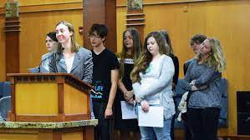
Logan Environmental Action Force (LEAF)

Slide 6
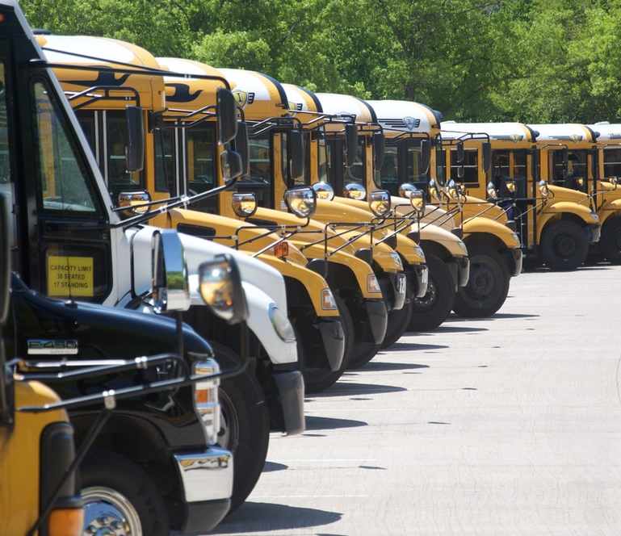
MI: Engaging Collaborative Respectful Evocative

Slide 7
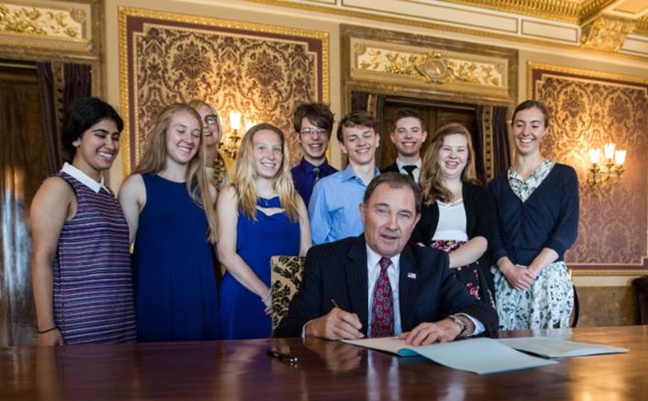
How a group of teenagers convinced the Utah legislature to recognize climate change”
By Isabella Gomez and Saeed Ahmed, CNN Updated 7:36 PM ET, Tue May 22, 2018

Slide 8
Lobbyists
Financial Counselors
Nurses
Physicians
Dieticians
CIO’s
Social Workers
Psychologists
Business Leaders

Slide 9
The 4 D’s:
Describe
Demo
Do
Discuss

Slide 10
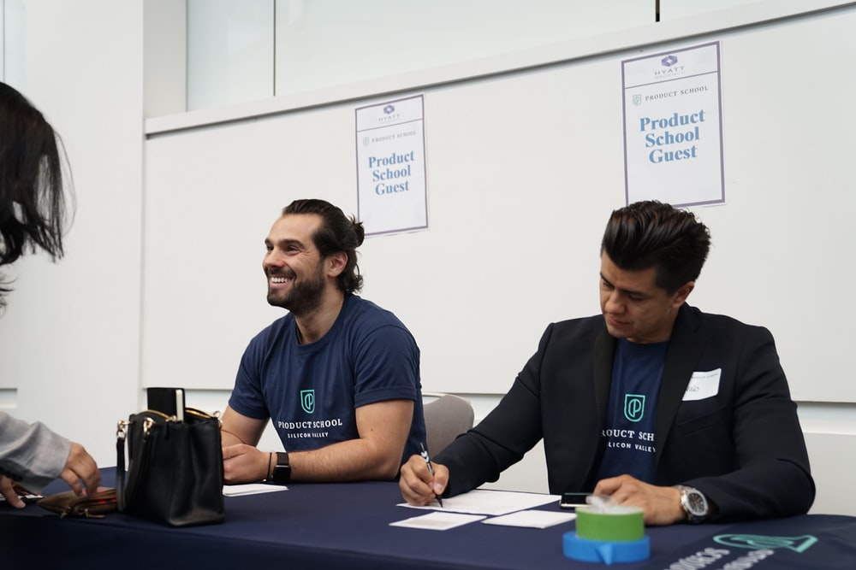
As RESULTS staff and volunteers, what kind of collaboration problems are you facing?

Slide 11
Agenda: Session 1
MI
Definition
History
Applications
Spirit of MI
Partnership
Acceptance
Compassion
Evocation
Four Processes
Engage
Focus
Evoke
Plan

Slide 12
MI’s Origin: Bill Miller
1983: The Milwaukee Problem

Slide 13
A Collaborative Difference
Traditional (Confrontational)
Collaborative
Provide reasons to change.
Focus on their failings.
Challenge their values.
Warn of bad consequences.
Problem is personalized.
Educate, lecture, instruct.
Evoke their reasons to change.
Affirm their abilities.
Utilize their values.
Focus on desired outcomes.
Problem is externalized.
Inquire, listen, invite.

Slide 14
Over 1400 published MI studies.

Slide 15
Demo: Recruiting The Ambivalent
I will invite you to join RESULTS using traditional methods.
I will invite you to join RESULTS using MI.
Notes:
To demonstrate how this ambivalence can play out in our interactions with others we are going to do an exercise.
[Exercise: Instruct participants to:
Find a partner.
Each of you write down something you are interested in doing but have mixed feelings about (e.g., buying a new car, quitting smoking, exercising, etc.).
Select who will speak first.
The speaker presents what it is that you would like to do (but haven’t done yet).
The listener then argues strongly in favor of one of the options or sides.
Speaker, your job is to listen and note what you are thinking and feeling.
Switch roles.]

Slide 16
MI moves them through the
Stages of Change
Maintenance
Consistent, Zealous
4. Action
Moving, Engaged, Acting.
3. Preparation
Open, Looking, Interested
2. Contemplation
Maybe, Ambivalent
1. Precontemplation
Angry, In Denial, Defensive

Slide 17
Recruiting for RESULTS
Traditional (Confrontational)
Collaborative (MI)
Provide reasons to change.
Focus on their failings.
Challenge their values.
Warn of bad consequences.
Problem is personalized.
Educate, lecture, instruct.
Evoke their reasons to change.
Affirm their abilities.
Utilize their values.
Focus on desired outcomes.
Problem is externalized.
Inquire, listen, invite.

Slide 18
Let’s Discuss
What did you notice?

Slide 19
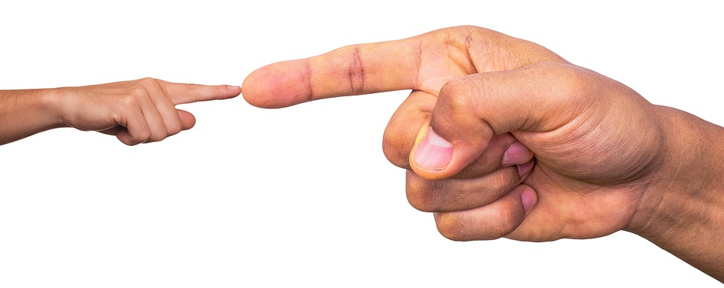
The Backfire Effect:
Well reasoned arguments can cause push back.

Slide 20
Don’t Personalize the Problem
They are the problem.
Us
Do Externalize the Problem
The Issue is the Problem
Us

Slide 21
The Spirit of MI: PACE Partnership Acceptance Compassion Evocation

Slide 22
Partnership
Collaborative vs. adversarial.
Partnering vs. personalizing.

Slide 23
Acceptance
Show unconditional caring.
Be empathic.
Understand vs. agree.
Respect their autonomy.
Affirm the good in them.
The appreciator

Slide 24
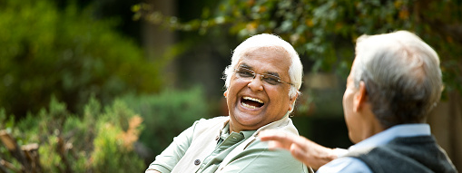
Compassion
Show respectful understanding of their:
Thoughts
Feelings
Values
Circumstances

Slide 25
Evocation
Draw out their ideas.
Help them find their reasons to cooperate.
Help them see how it serves their values.

Slide 26
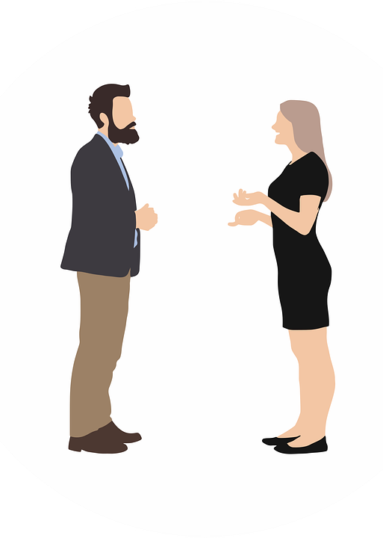
Evocation
People are more persuaded by the ideas you draw from them than ones offered directly.

Slide 27
Let’s Practice The Spirit of MI: PACE
Identify someone you’d like to influence (no names) .
Write your negative attitude of them.
Write a more compassionate view:
Affirm something about them.
Identify values you share.
Empathize with their perspective.

Slide 28
Let’s Discuss
Your negative attitude.
Affirmation, Shared Values, Empathize with their Perspective

Slide 29
The Four Processes: 1. Engage 2. Focus 3. Evoke 4. Plan

Slide 30
Engage
Mine
Ours
Theirs
Find common goals and values.

Slide 31
Conservative Values
Individual liberty
Energy freedom
Economic security
Business/Job growth
National Security
Market-based solutions
Individual responsibility
Fairness based on effort
Treating people equally
Respect for innocent life
Patriotism/Nationalism
Deference to tradition
Avoiding radical changes
Eliminating subsidies
American ingenuity
Improving infrastructure
Privatization
Reduced regulations
Sustainability
Supporting families
Protect taxpayers
Revenue neutrality
Reducing spending
Conservative leadership
Avoid big spending
Smaller government

Slide 32
Let’s Practice
Identify one or more ways you can promote RESULTS’ agenda using conservative values.

Slide 33
Individual liberty
Energy freedom
Economic security
Business/Job growth
National Security
Market-based solutions
Individual responsibility
Fairness based on effort
Treating people equally
Respect for innocent life
Patriotism/Nationalism
Deference to tradition
Avoiding radical changes
Eliminating subsidies
American ingenuity
Improving infrastructure
Privatization
Reduced regulations
Sustainability
Supporting families
Protect taxpayers
Revenue neutrality
Reducing spending
Conservative leadership
Avoid big spending
Smaller government

Slide 34
FOCUS
It they’re hostile- explore their values.
If they’re supportive- plan your action.
If they’re ambivalent- foster change talk.

Slide 35
Evoke Change Talk: DARN CAT
Desires
Abilities
Reasons
Needs
Commitment
Activation
Taking Steps

Slide 36
Plan
Link every interaction to the next.
Make strategic summaries.

Slide 37
Questions

Slide 38
Practice Suggestions
Practice PACE at home and work.
Collaborate to avoid the backfire effect.
Learn others’ values and collaborate using them.
Externalize vs. personalize problems.
Adjust your approach to their stage of change.

Slide 39
Next Session: Oct. 27
The Core Skills:
Open Questions
Affirmations
Reflective Listening
Summaries

